Slide 1
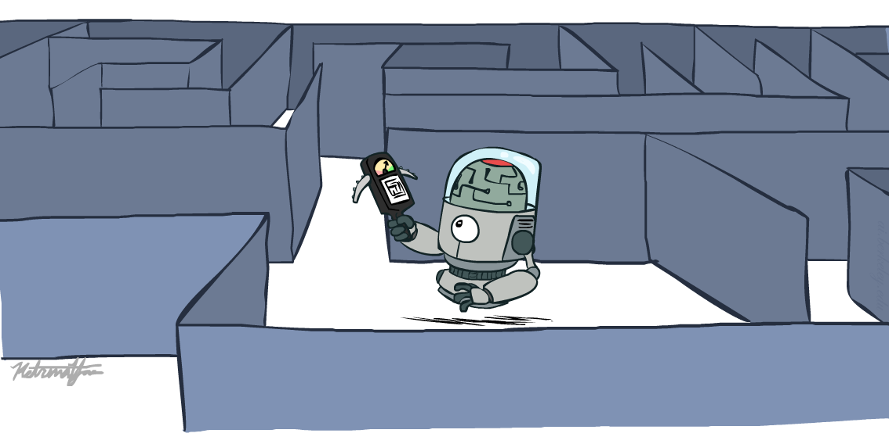
CS 106: Artificial Intelligence
Informed Search
Instructor: Ngoc-Hoang LUONG, PhD
University of Information Technology (UIT), VNU-HCM
[These slides were created by Dan Klein and Pieter Abbeel for CS188 Intro to AI at UC Berkeley. All CS188 materials are available at http://ai.berkeley.edu.]
Notes:
Please retain proper attribution, including the reference to ai.berkeley.edu. Thanks!

Slide 2
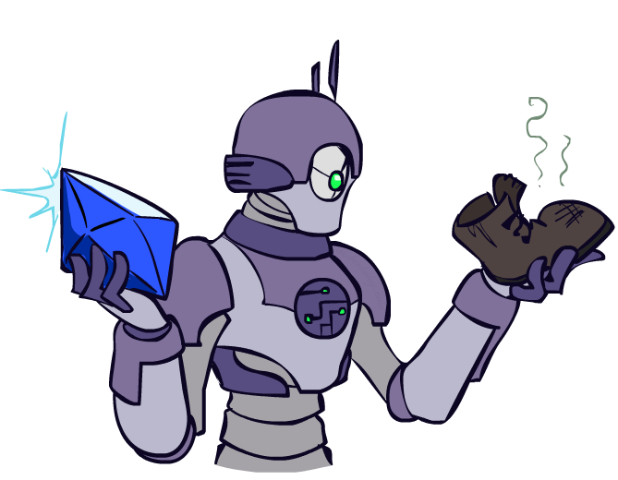
Today
Informed Search
Heuristics
Greedy Search
A* Search
Tree Search versus Graph Search

Slide 3

Recap: Search

Slide 4
Recap: Search
Search problem:
States (configurations of the world)
Actions and costs
Successor function (world dynamics)
Start state and goal test
Search tree:
Nodes: represent plans for reaching states
Plans have costs (sum of action costs)
Search algorithm:
Systematically builds a search tree
Chooses an ordering of the fringe (unexplored nodes)
Optimal: finds least-cost plans

Slide 5
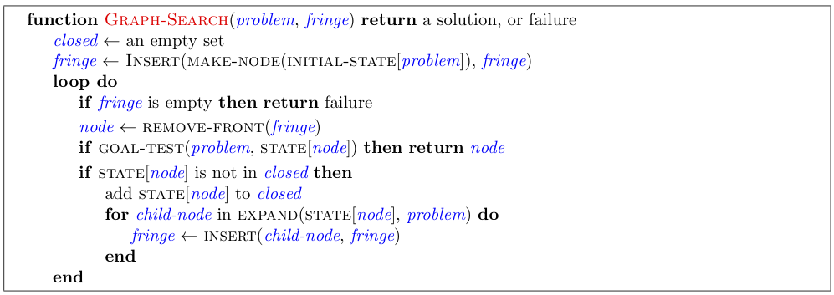
Graph Search Pseudo-Code

Slide 6

Uninformed Search

Slide 7
Uniform Cost Search
Strategy: expand lowest path cost
The good: UCS is complete and optimal!
The bad:
Explores options in every “direction”
No information about goal location
c ≤ 1
…
c ≤ 2
c ≤ 3
Start
Goal
[Demo: contours UCS empty (L3D1)]
[Demo: contours UCS pacman small maze (L3D3)]

Slide 8

Video of Demo Contours UCS Empty

Slide 9
Video of Demo Contours UCS Pacman Small Maze

Slide 10

Informed Search

Slide 11



Search Heuristics
A heuristic is:
A function that estimates how close a state is to a goal
Designed for a particular search problem
Examples: Manhattan distance, Euclidean distance for pathing
10
5
11.2

Slide 12
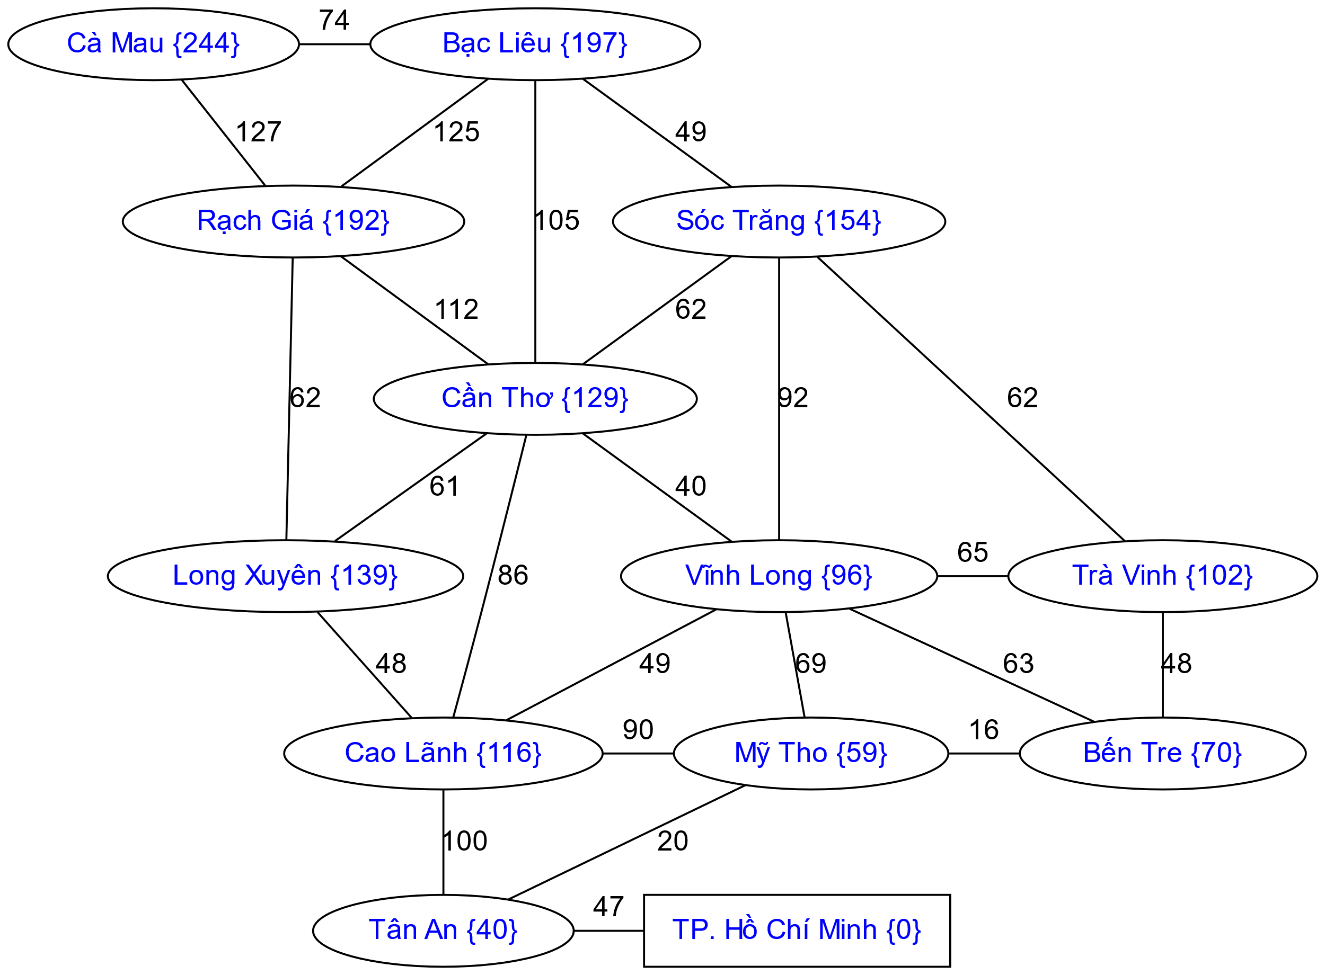
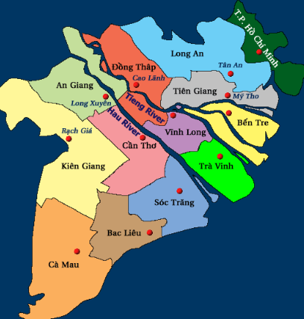
Example: Heuristic Function
{h(x)} = straight line distance to Ho Chi Minh city.

Slide 13

Greedy Search
Strategy: expand the node that seems closest

Slide 14
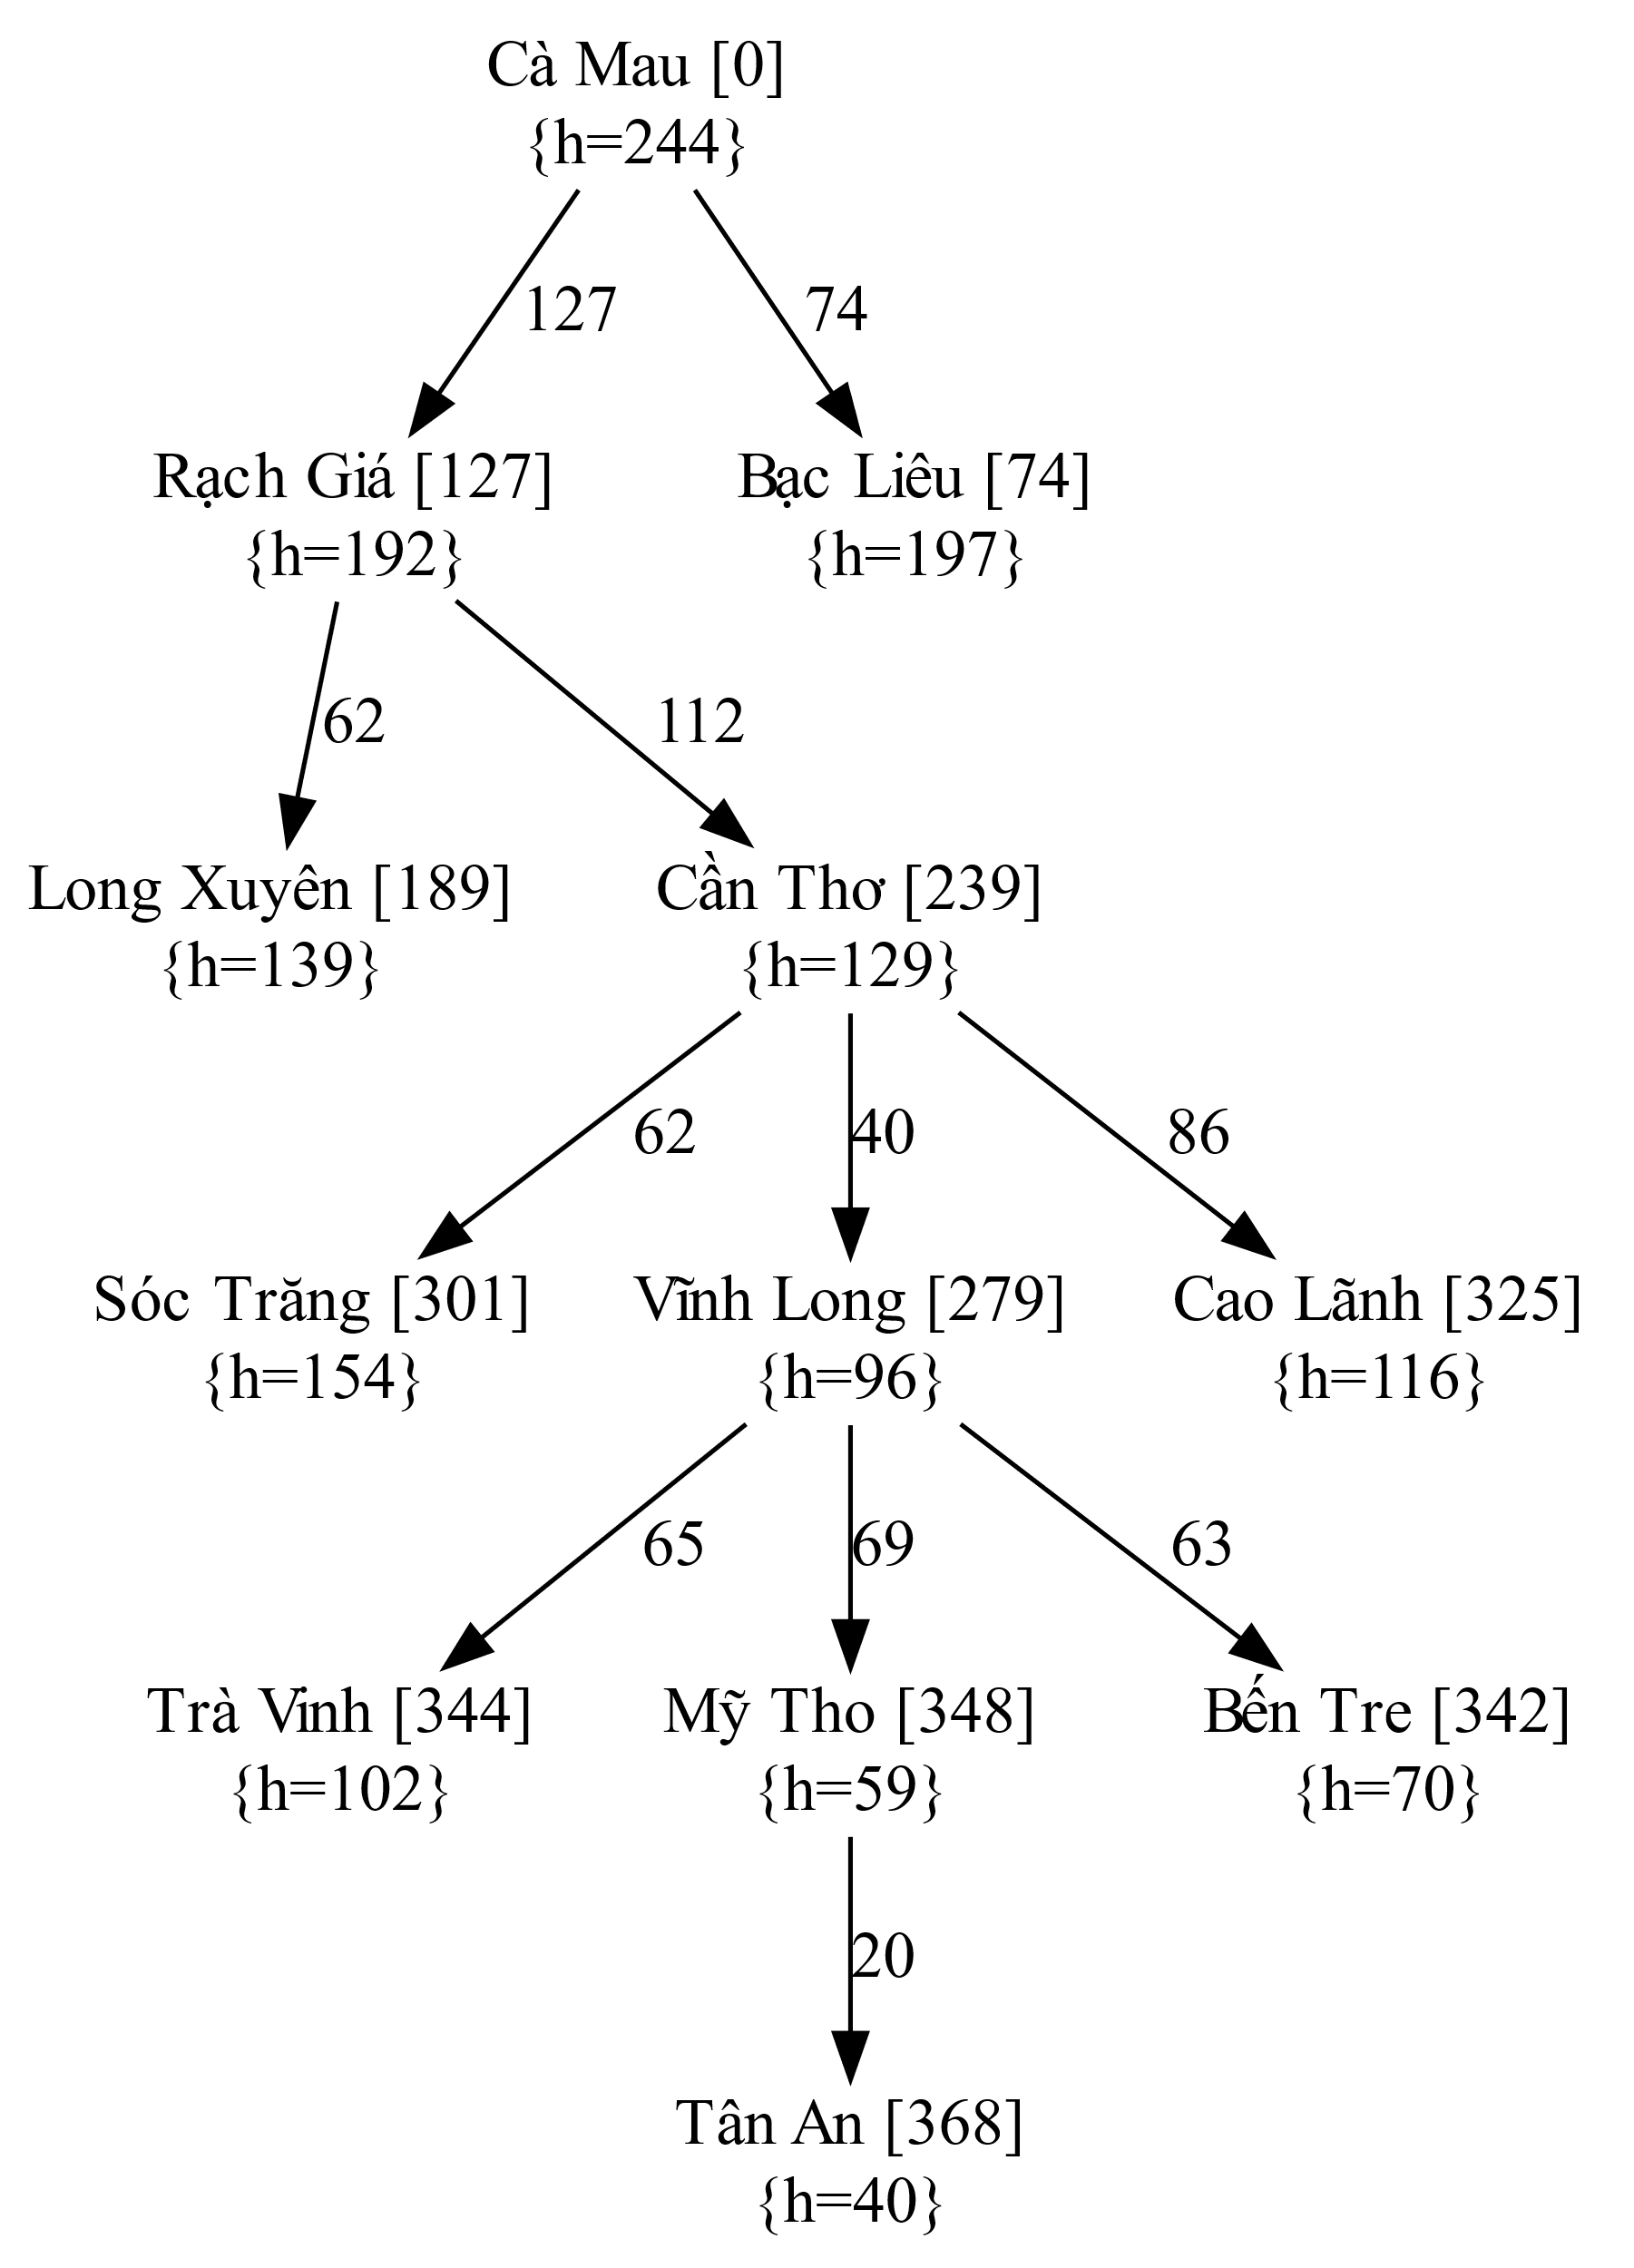
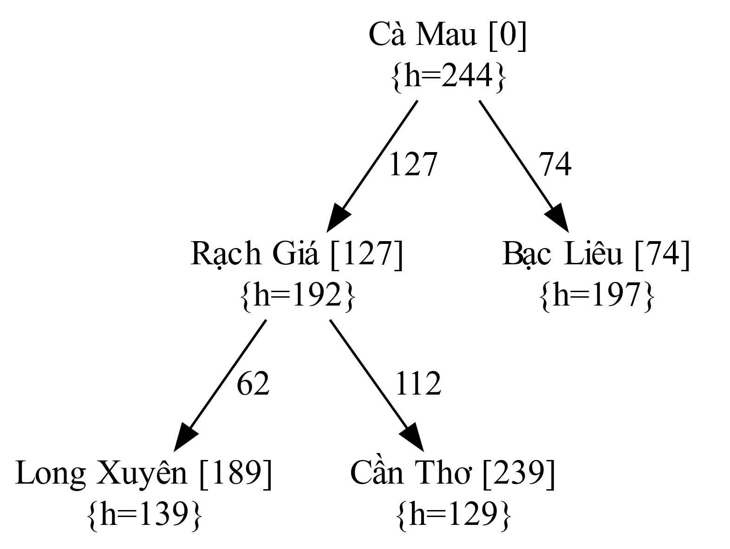
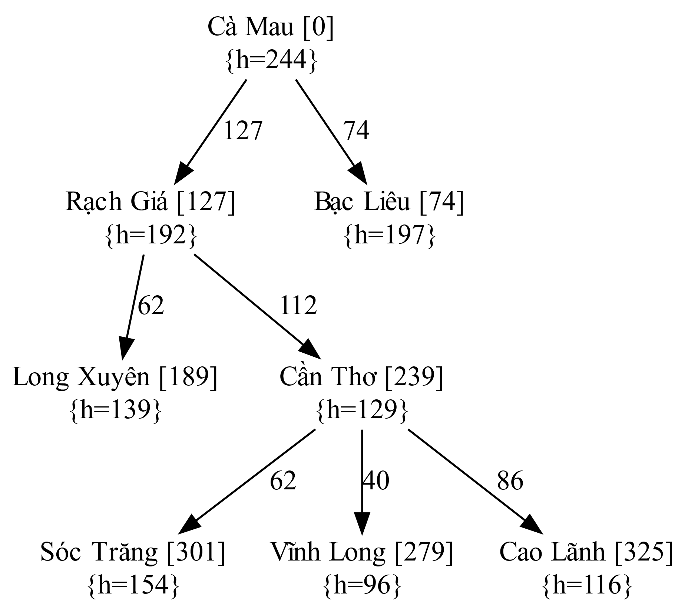
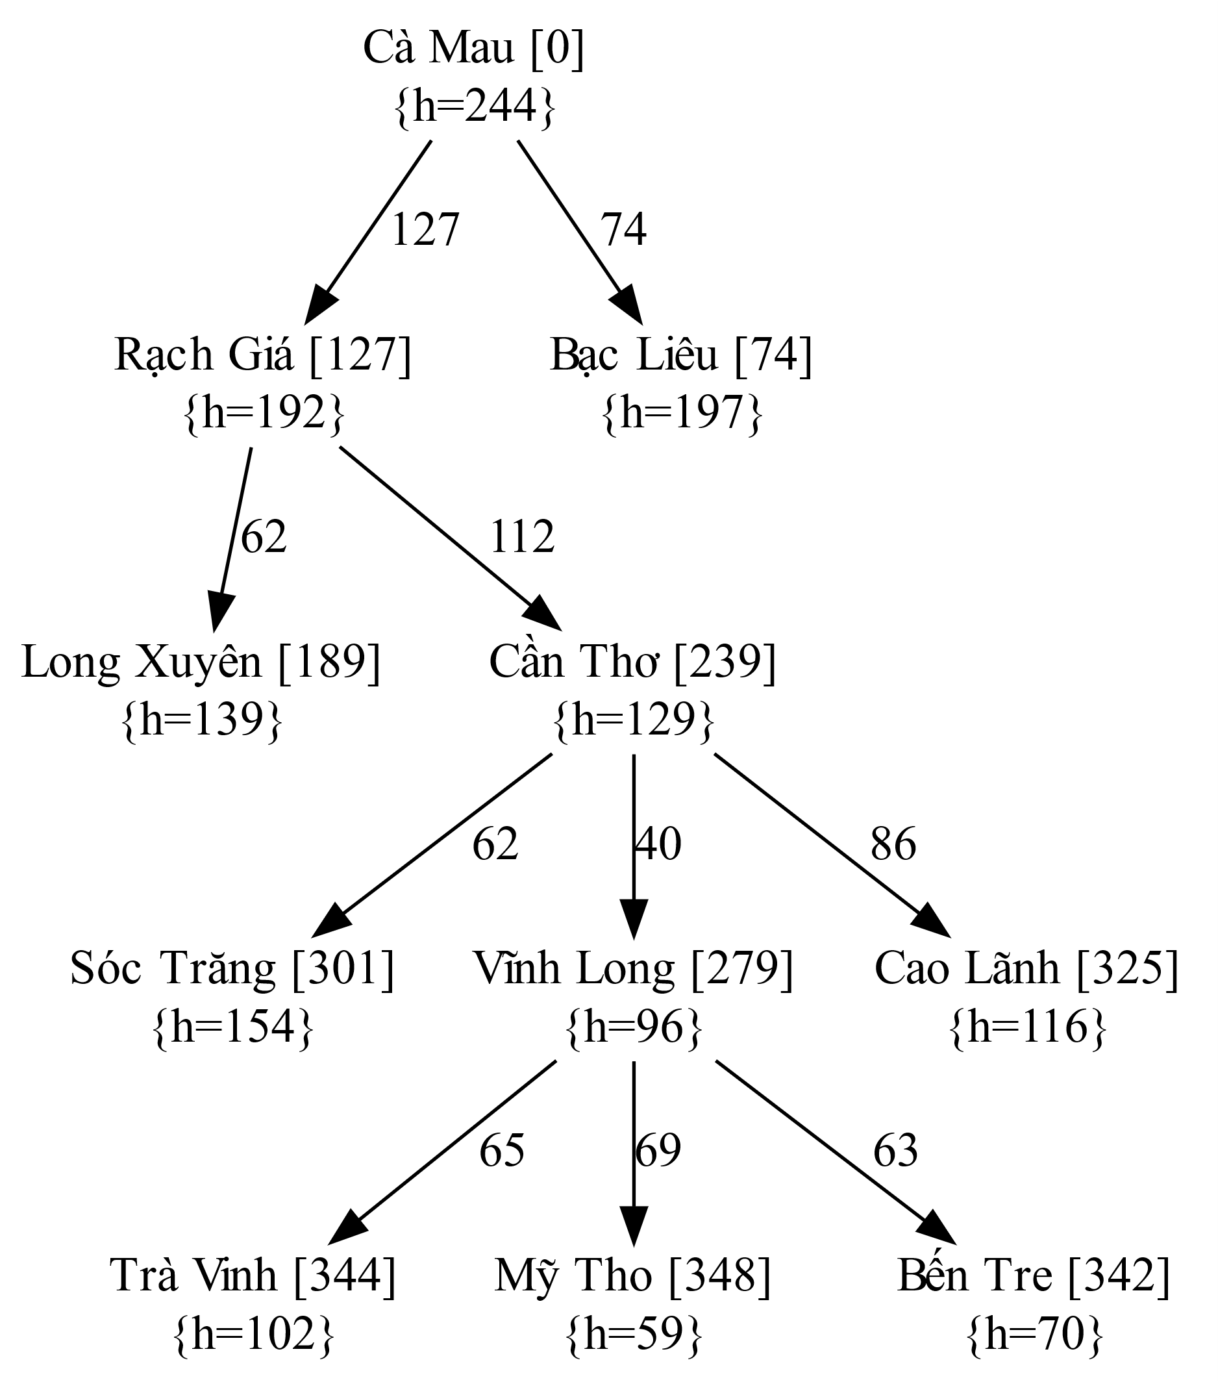
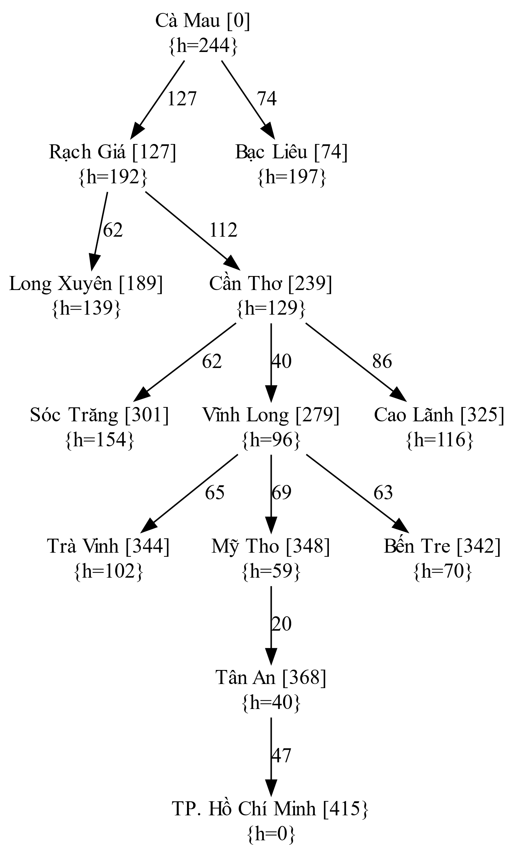
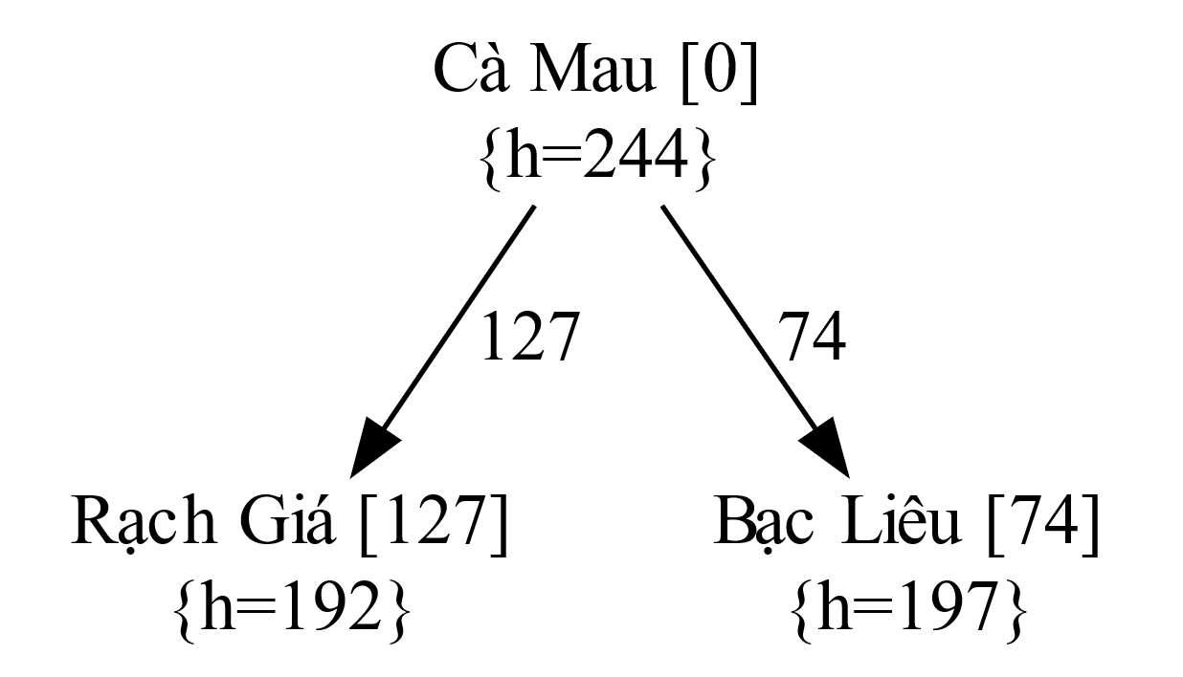
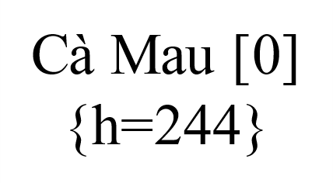
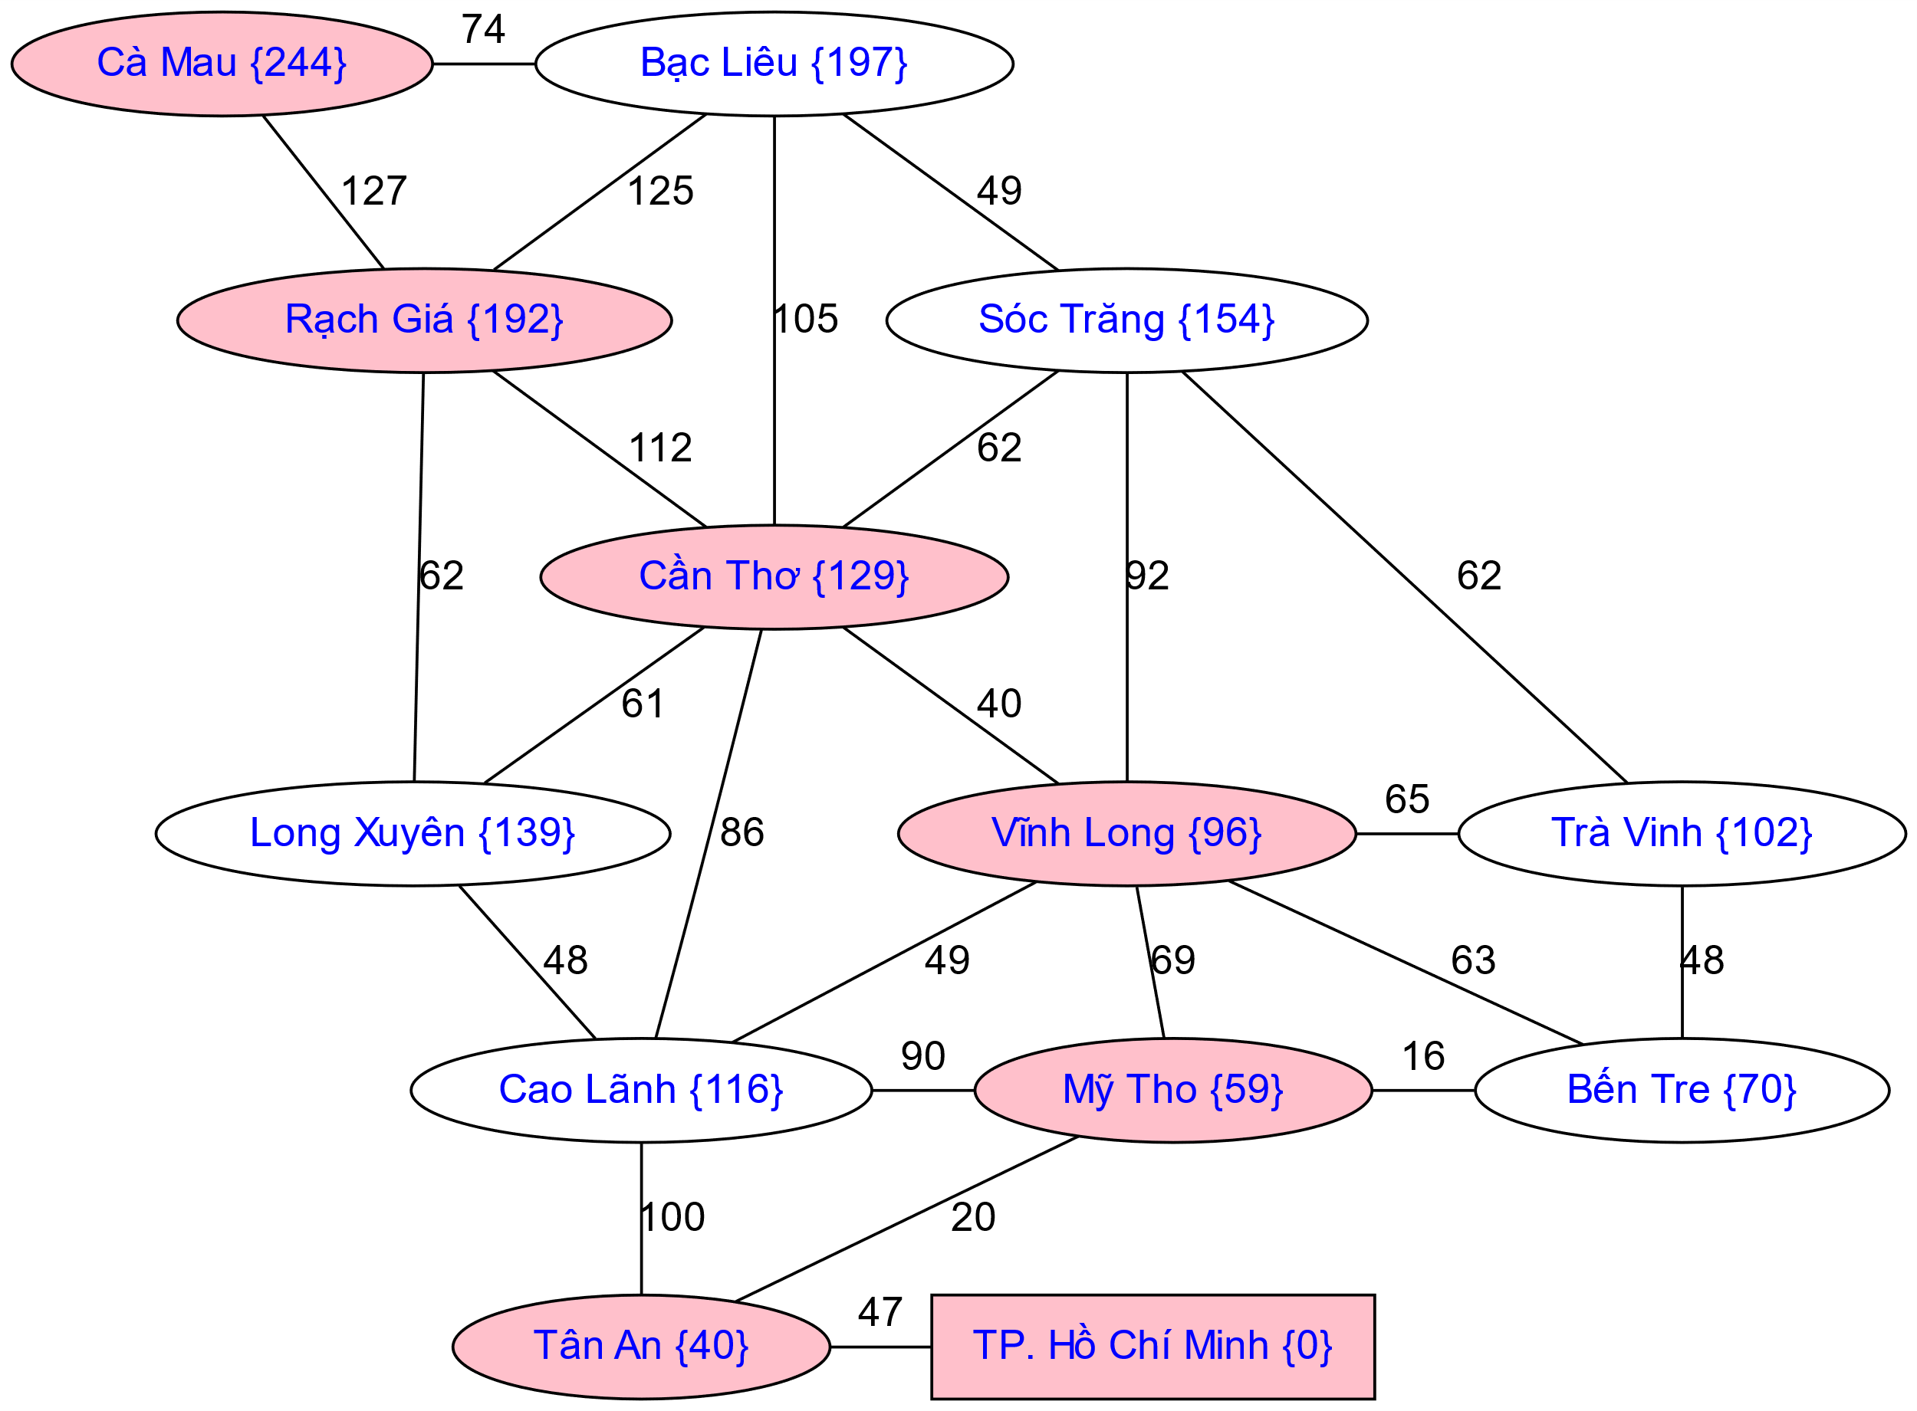
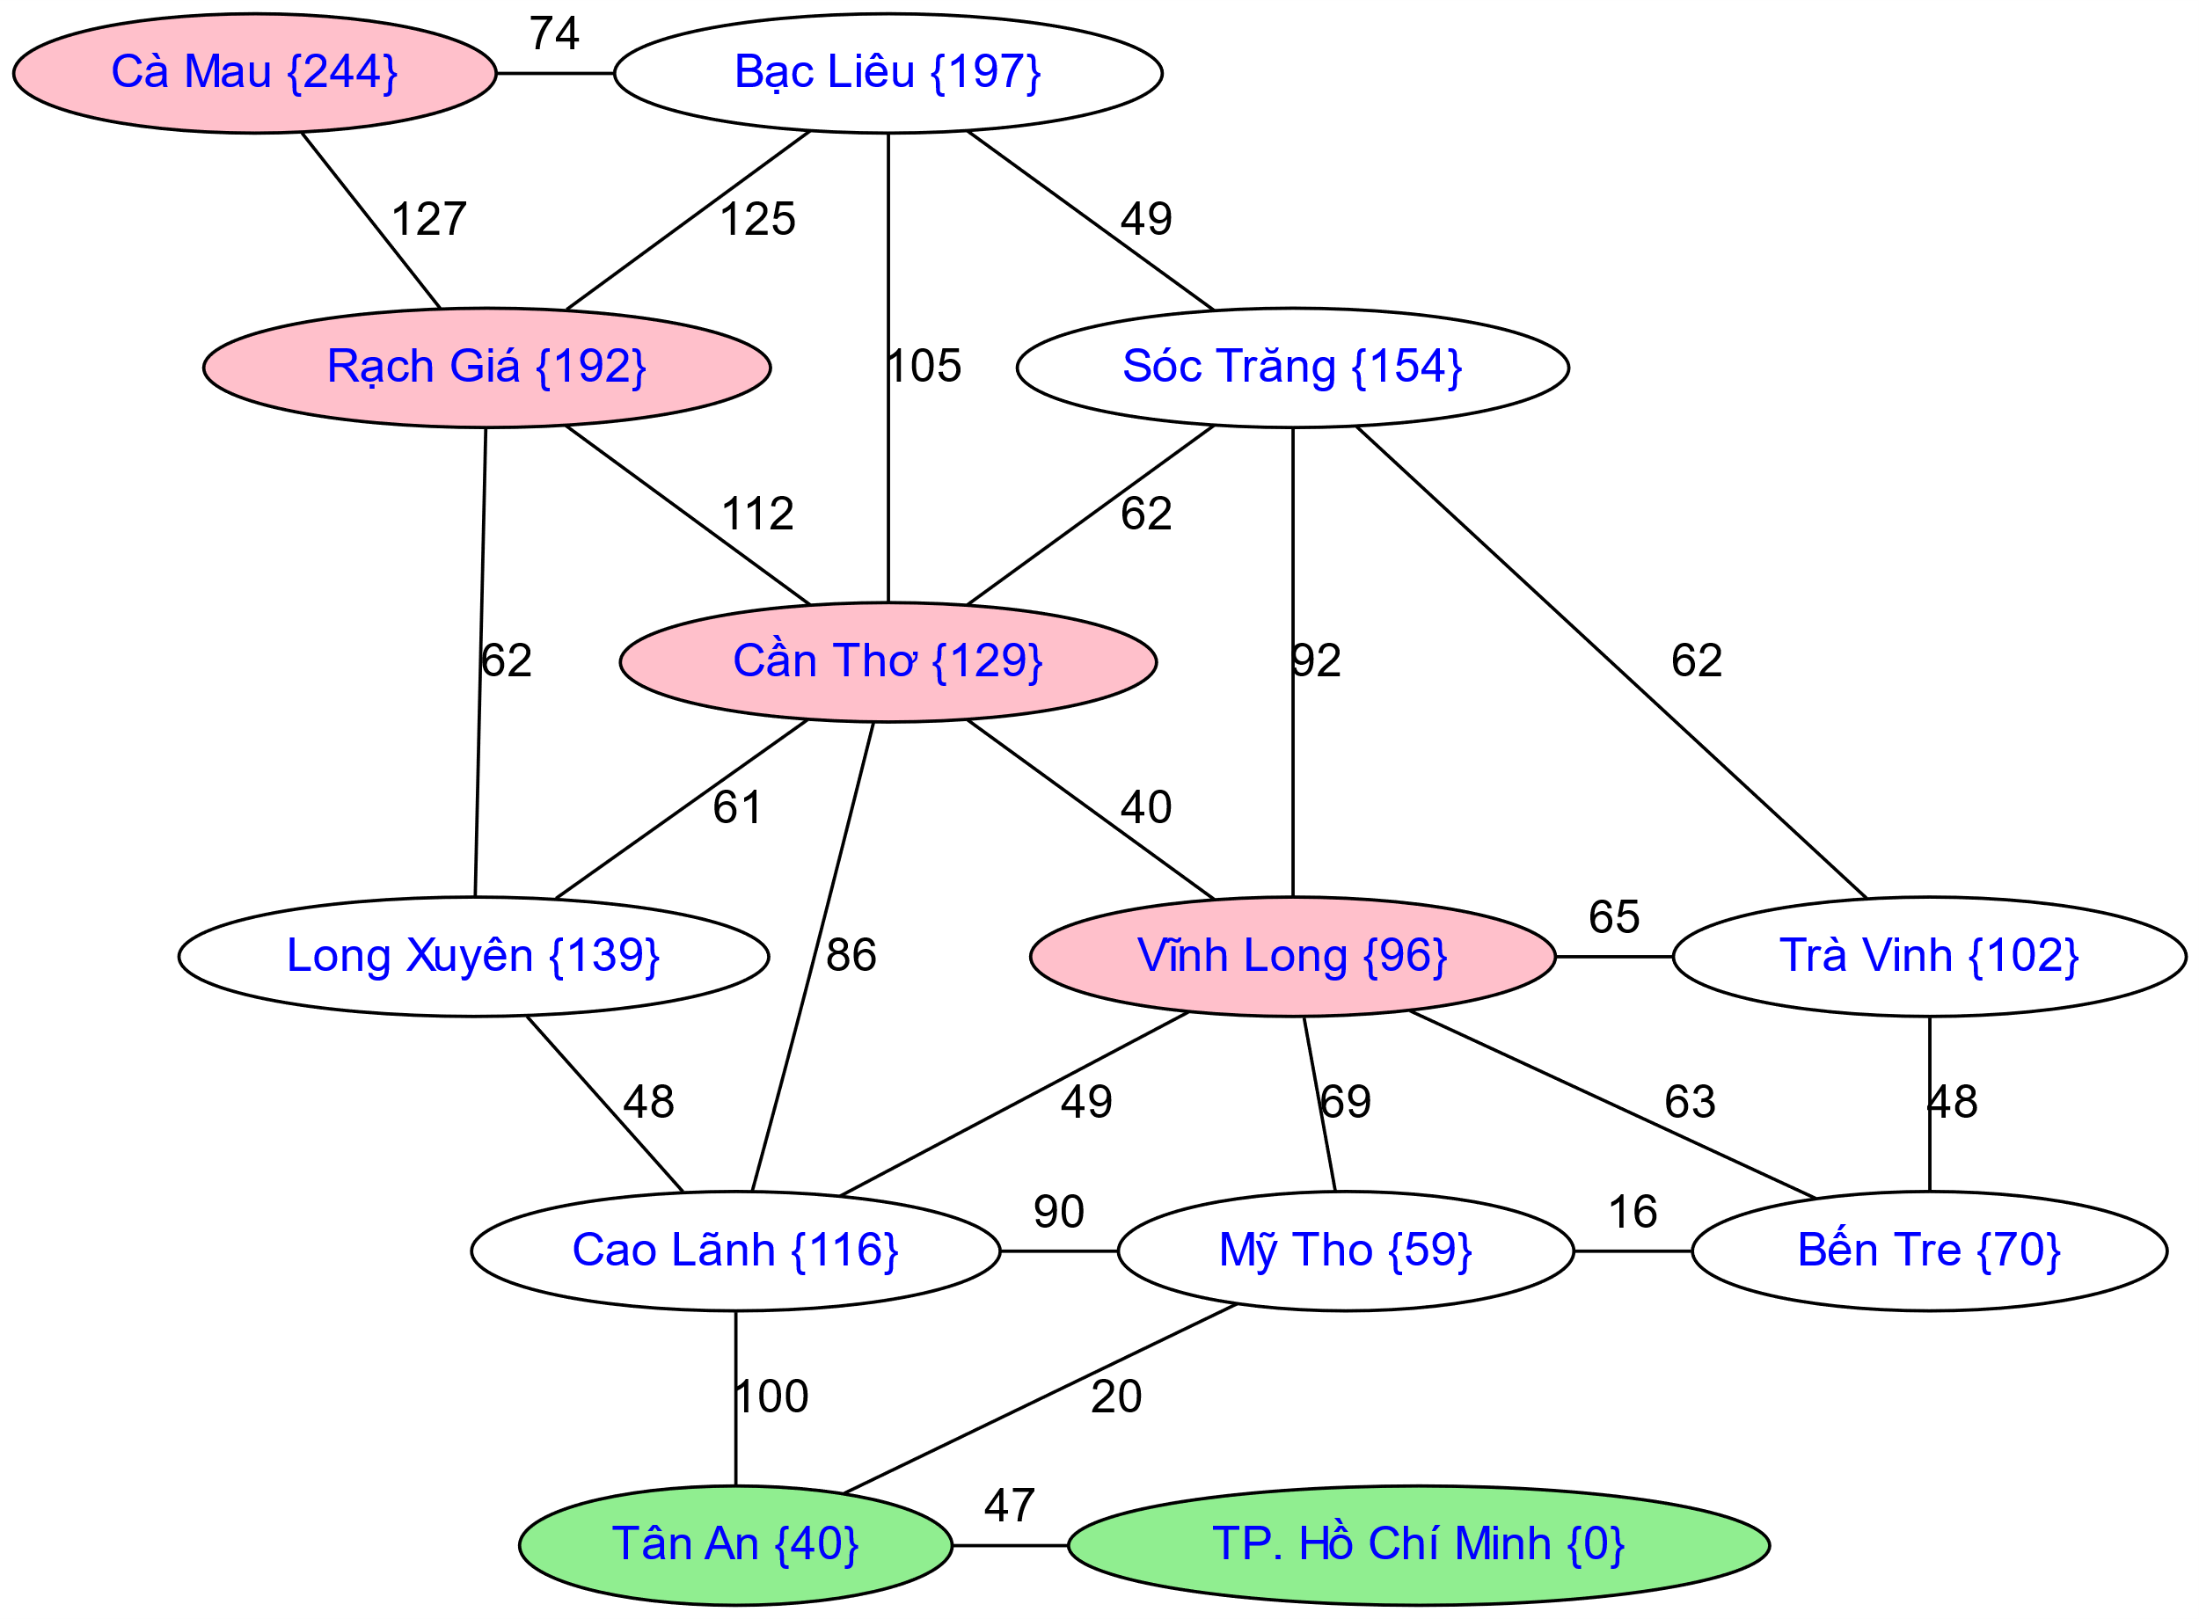
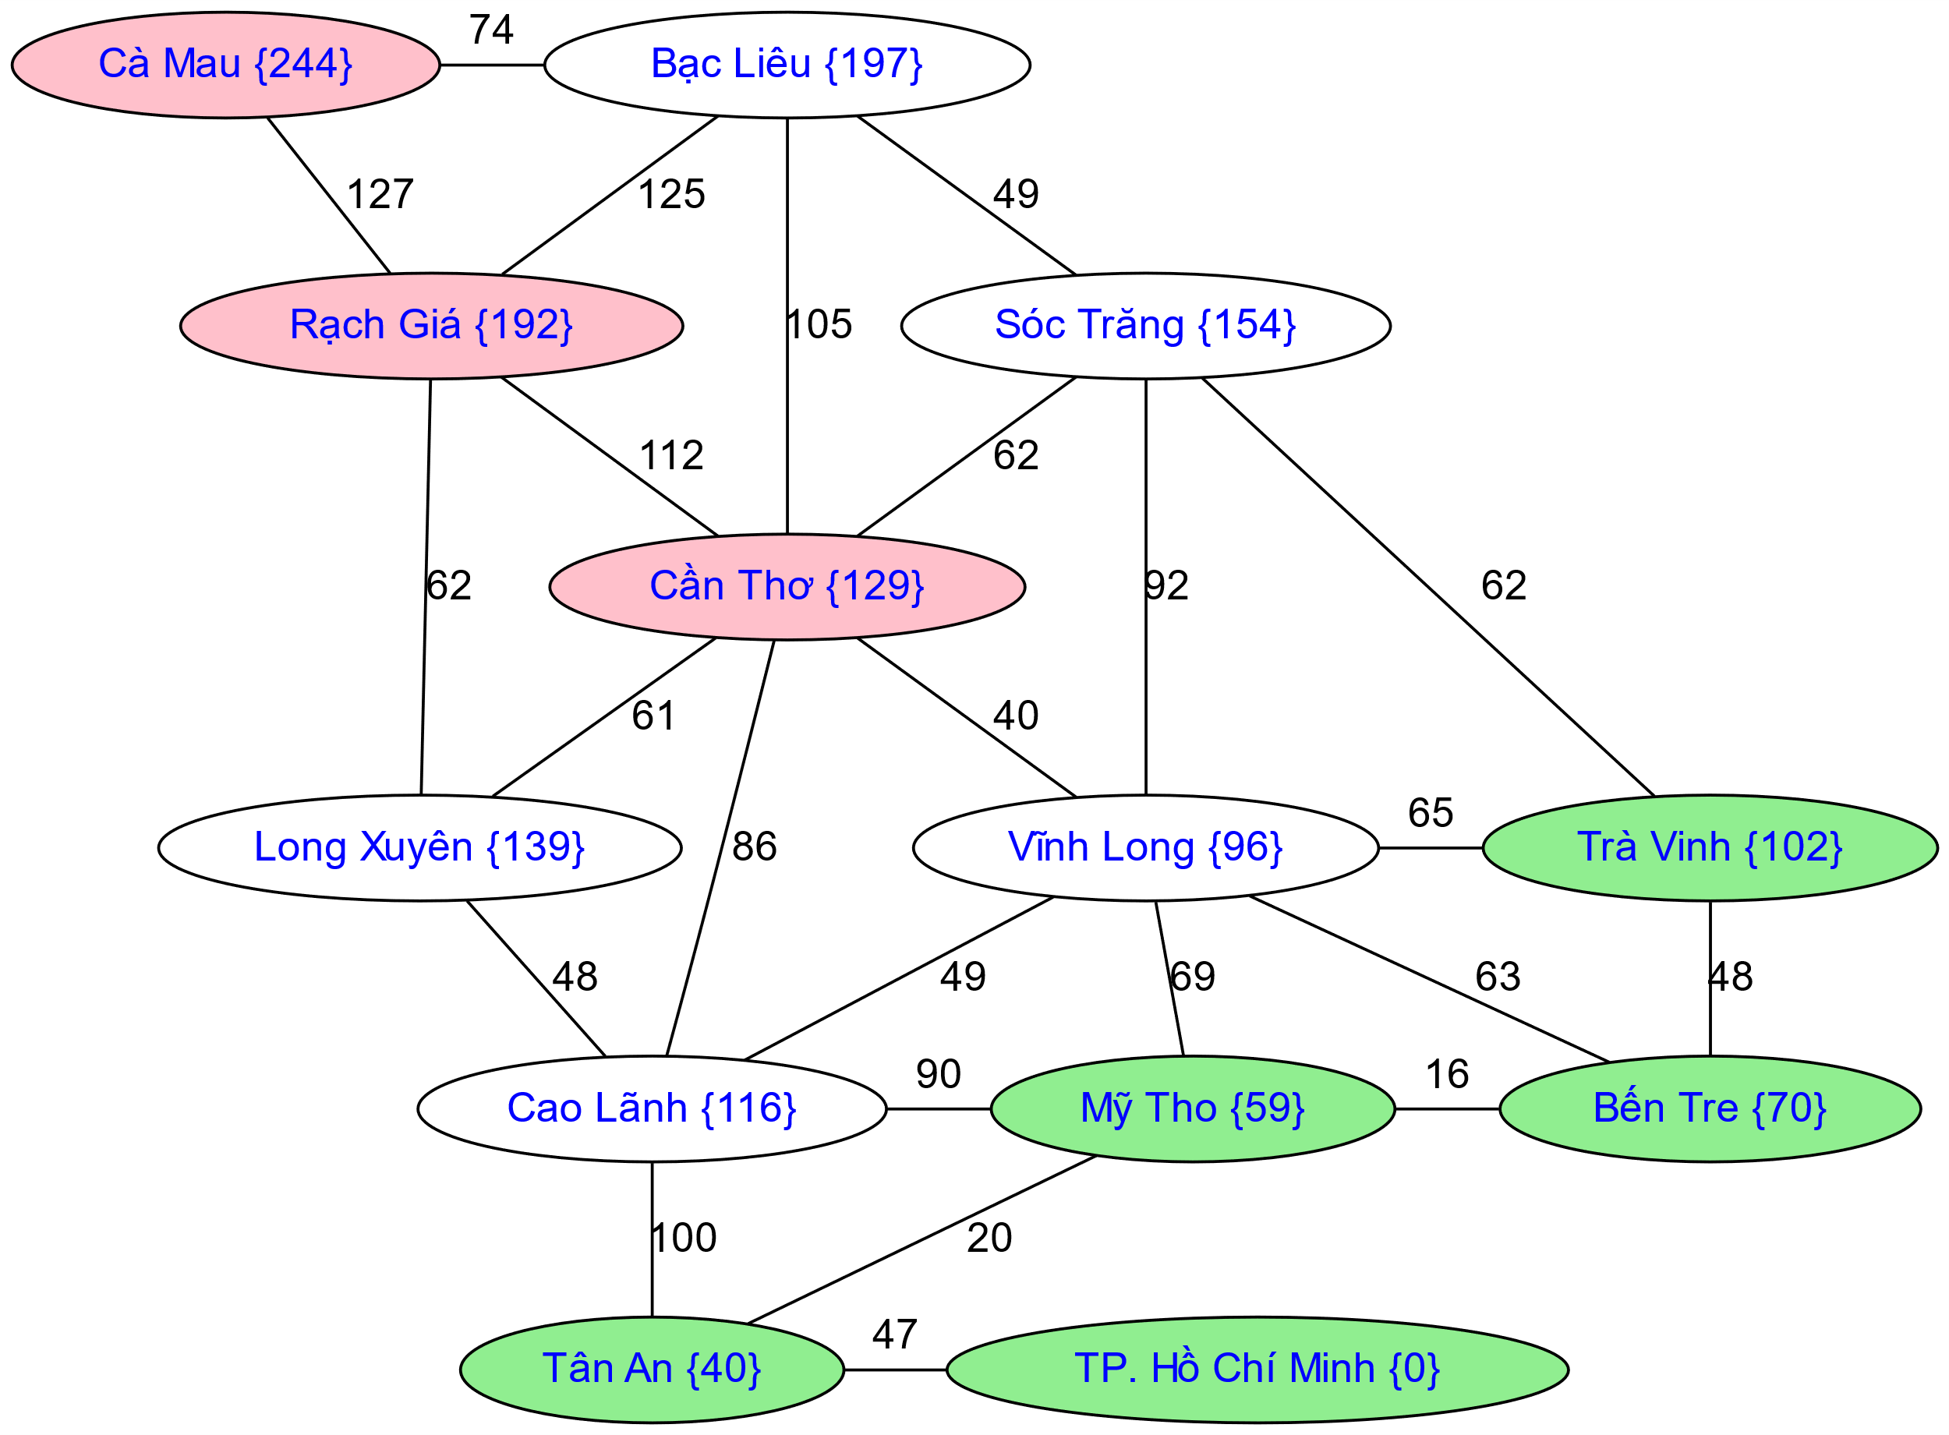
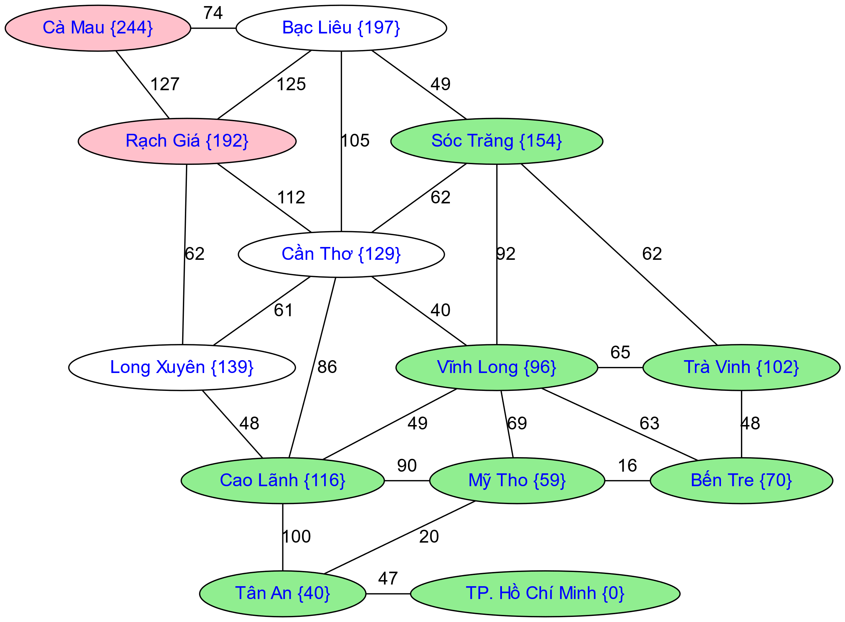
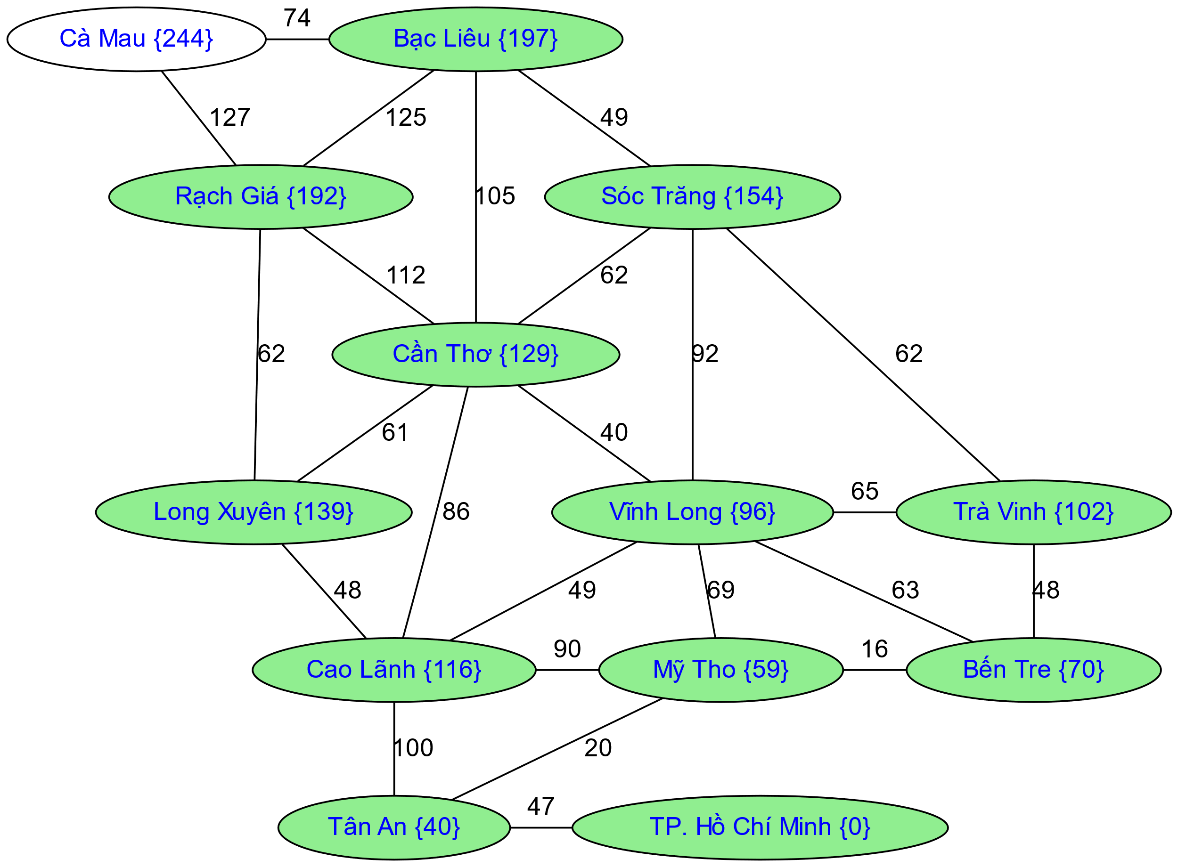
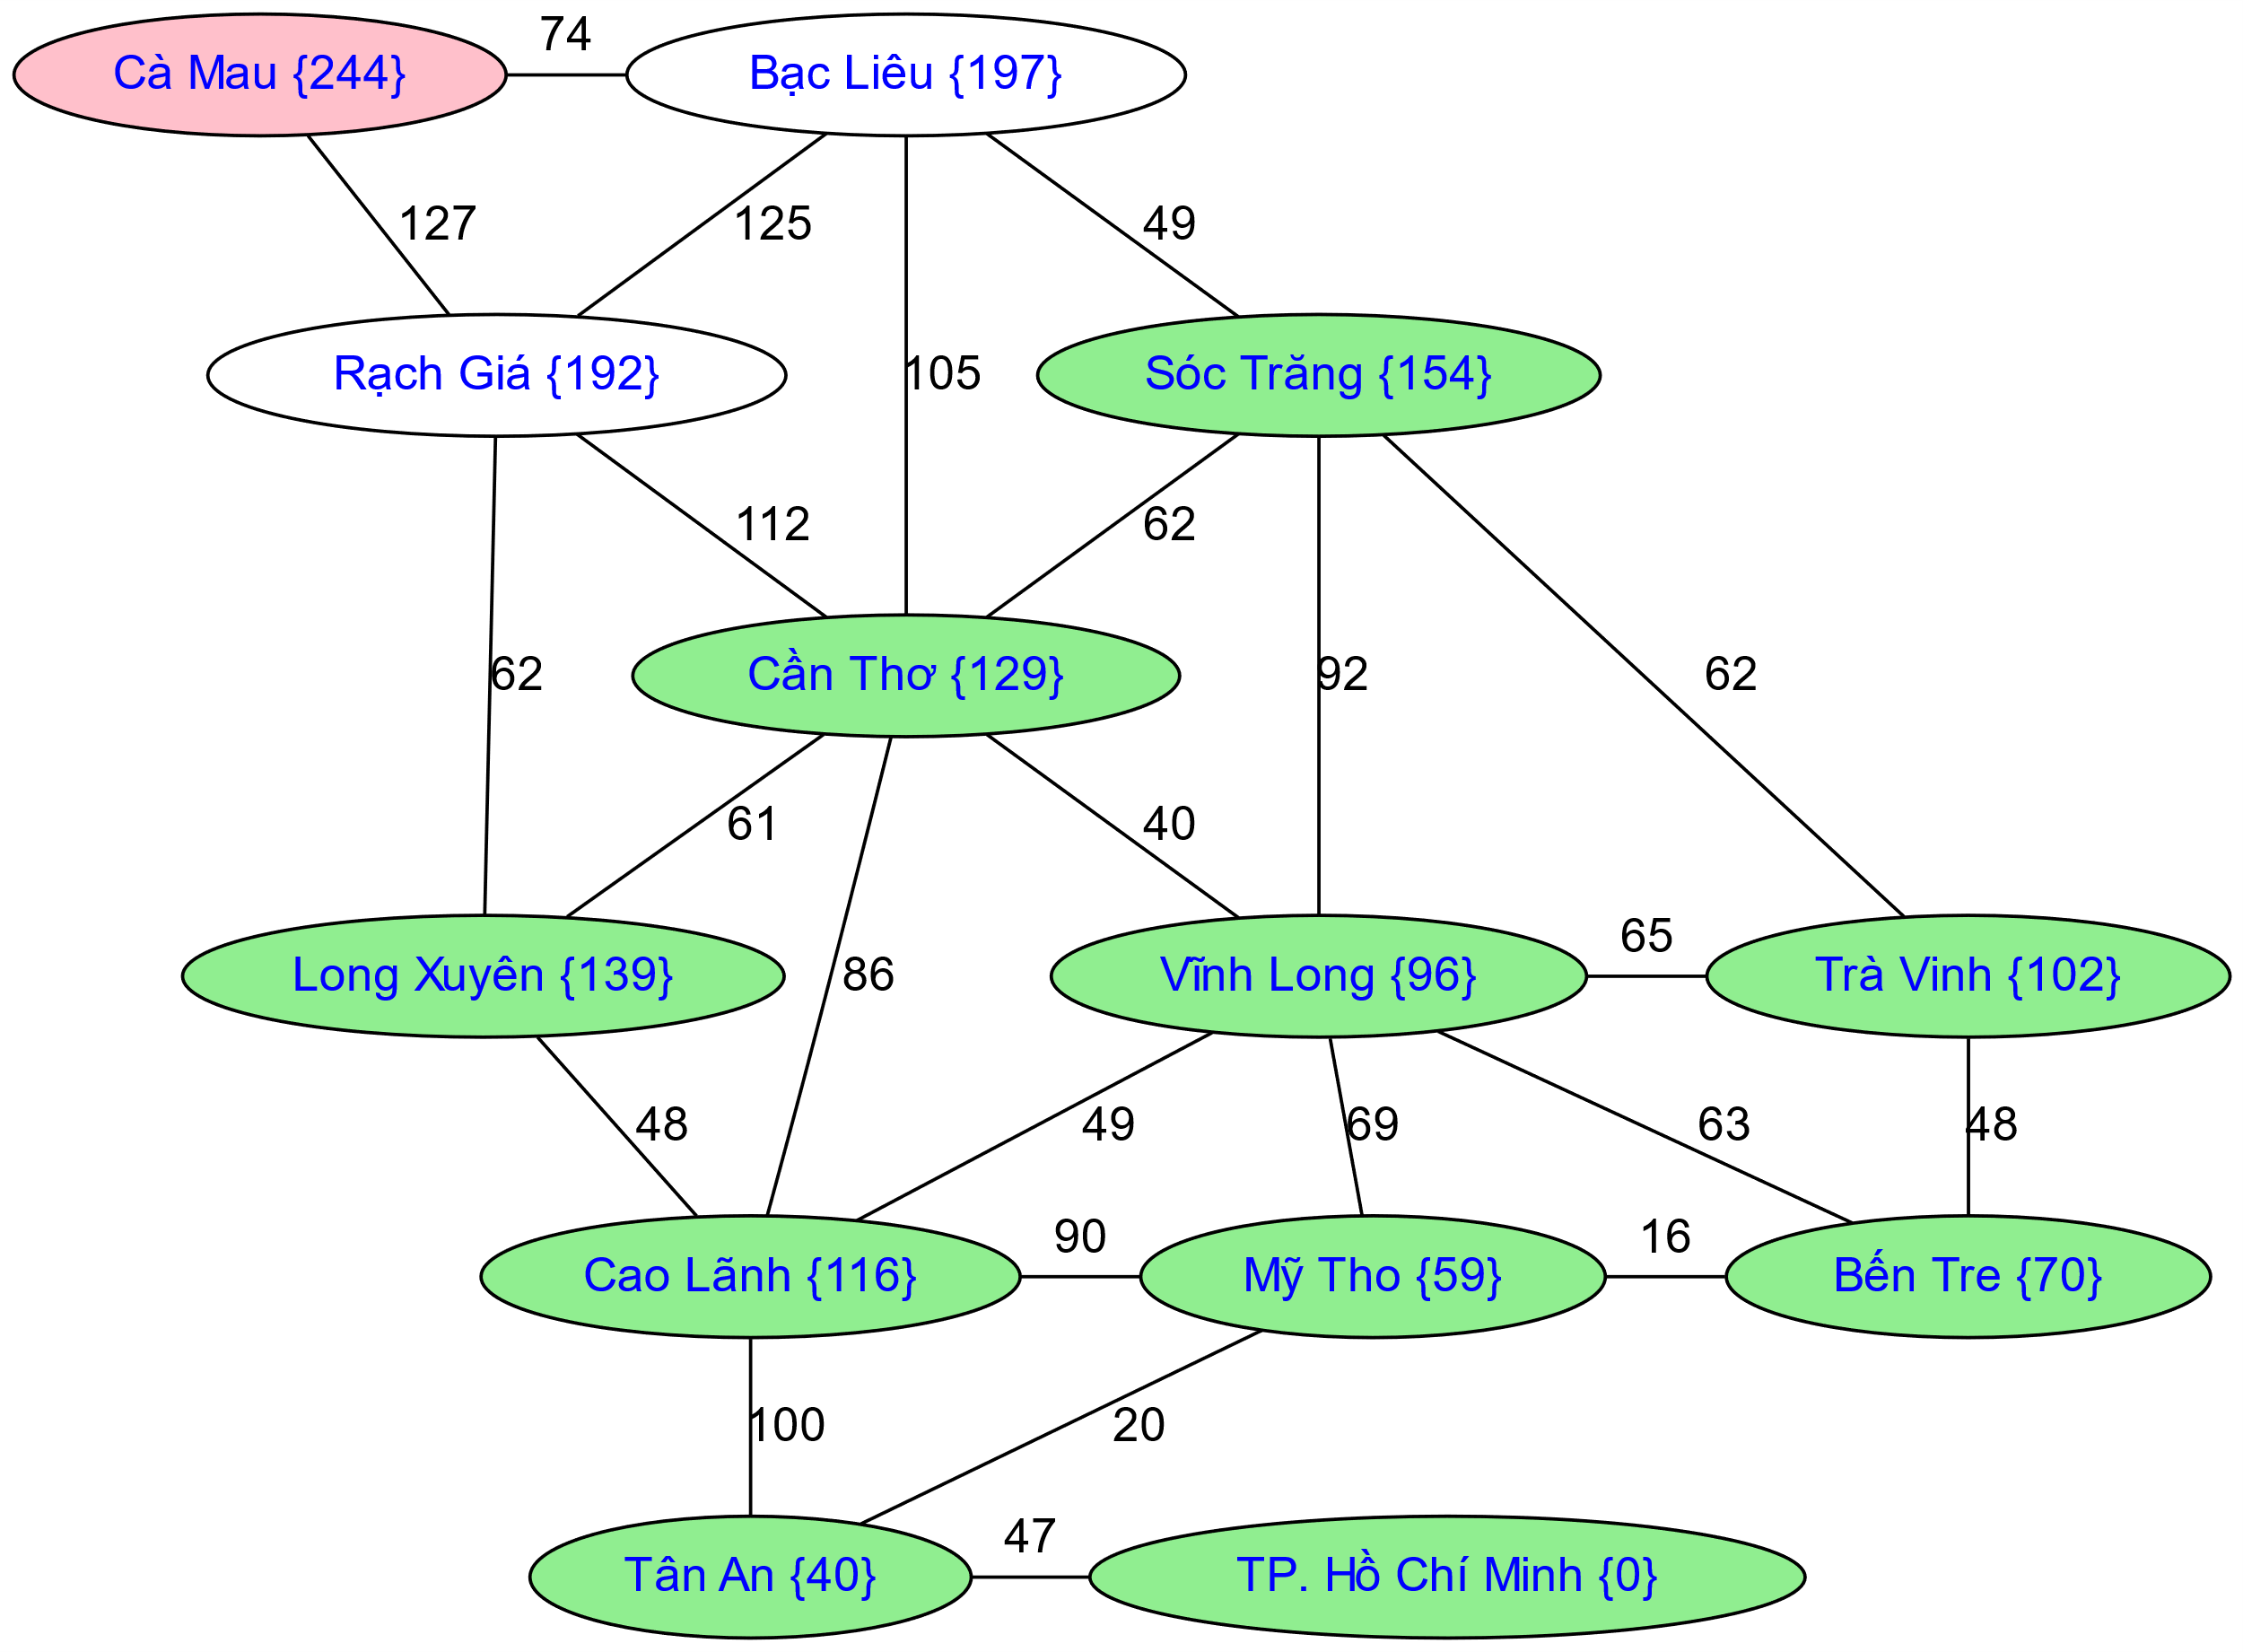
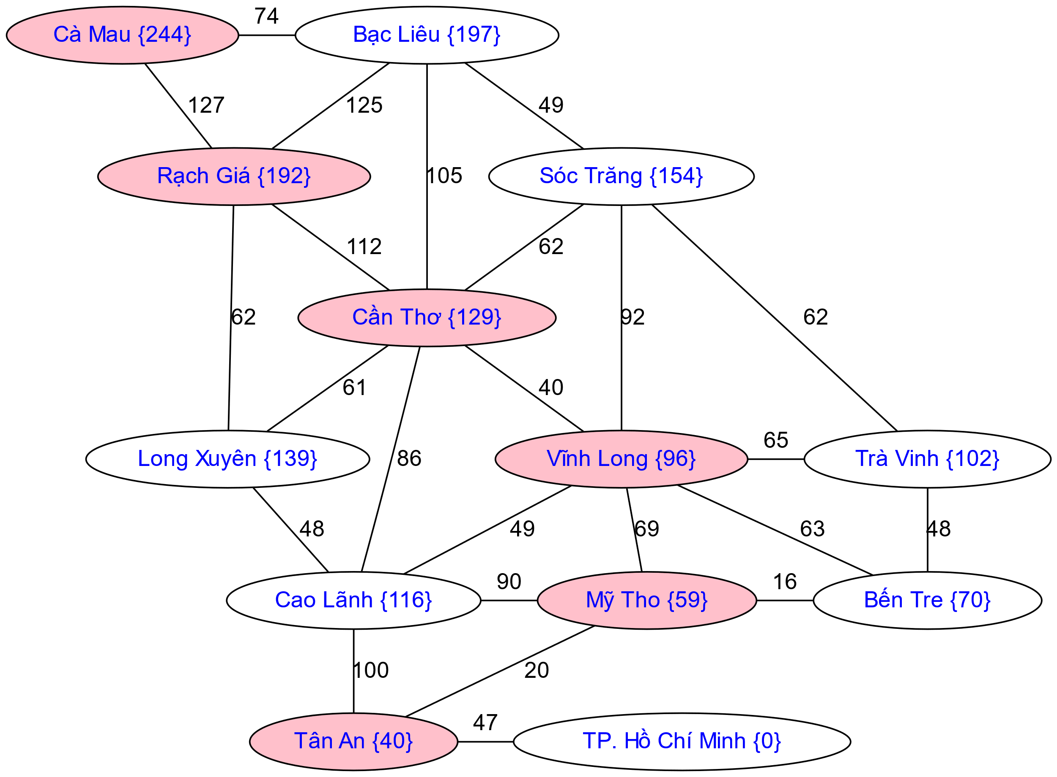
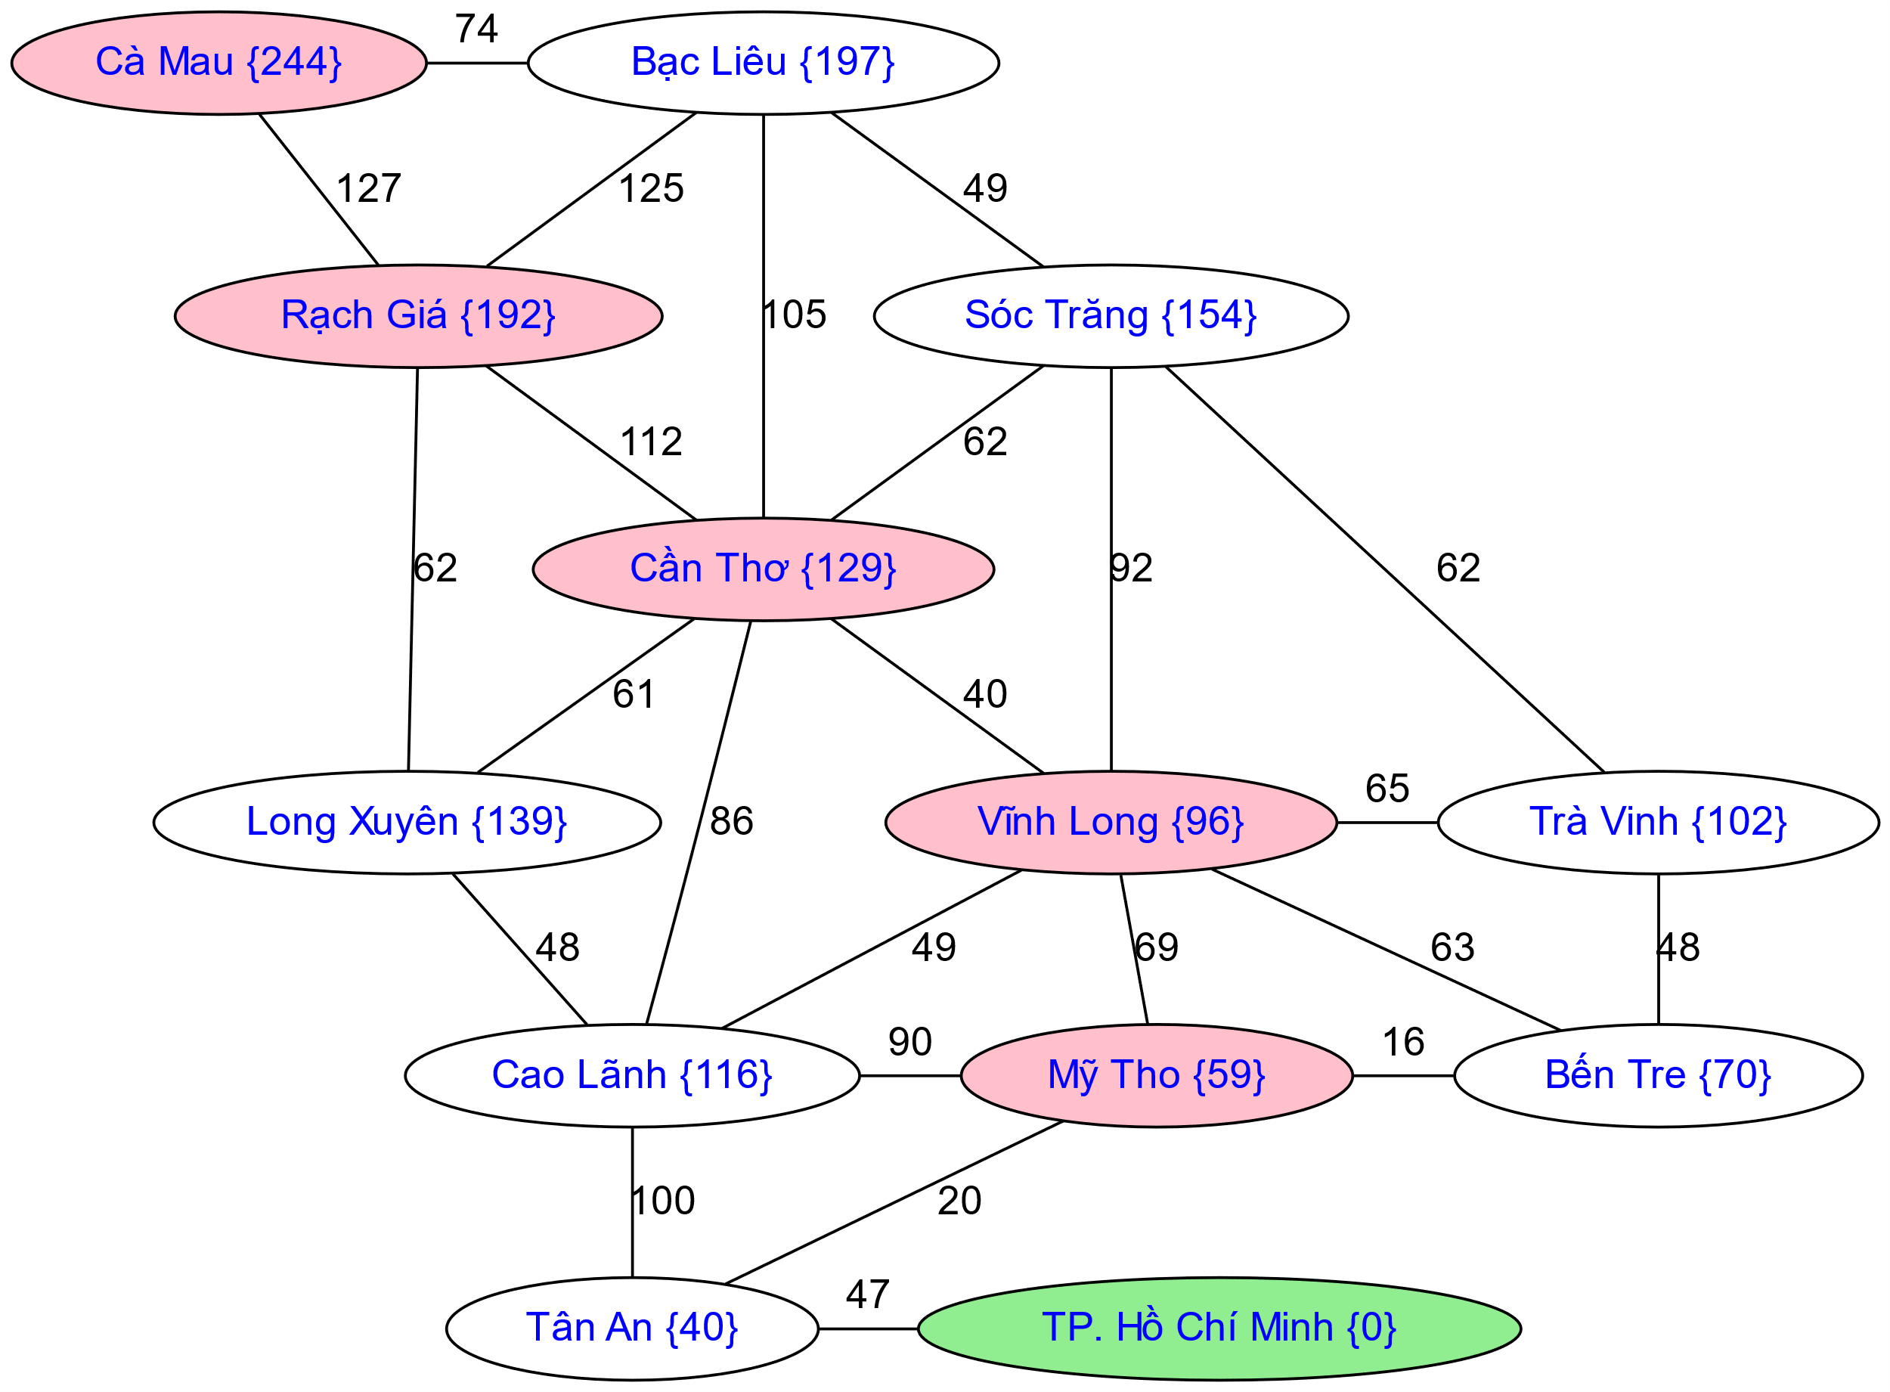
Greedy Search

Slide 15
Greedy Search
b
Strategy: expand a node that you think is closest to a goal state
Heuristic: estimate of distance to nearest goal for each state
A common case:
Best-first takes you straight to the (wrong) goal
Worst-case: like a badly-guided DFS
…
b
…
[Demo: contours greedy empty (L3D1)]
[Demo: contours greedy pacman small maze (L3D4)]
Notes:
For any search problem, you know the goal. Now, you have an idea of how far away you are from the goal.

Slide 16
Video of Demo Contours Greedy (Empty)

Slide 17
Video of Demo Contours Greedy (Pacman Small Maze)

Slide 18
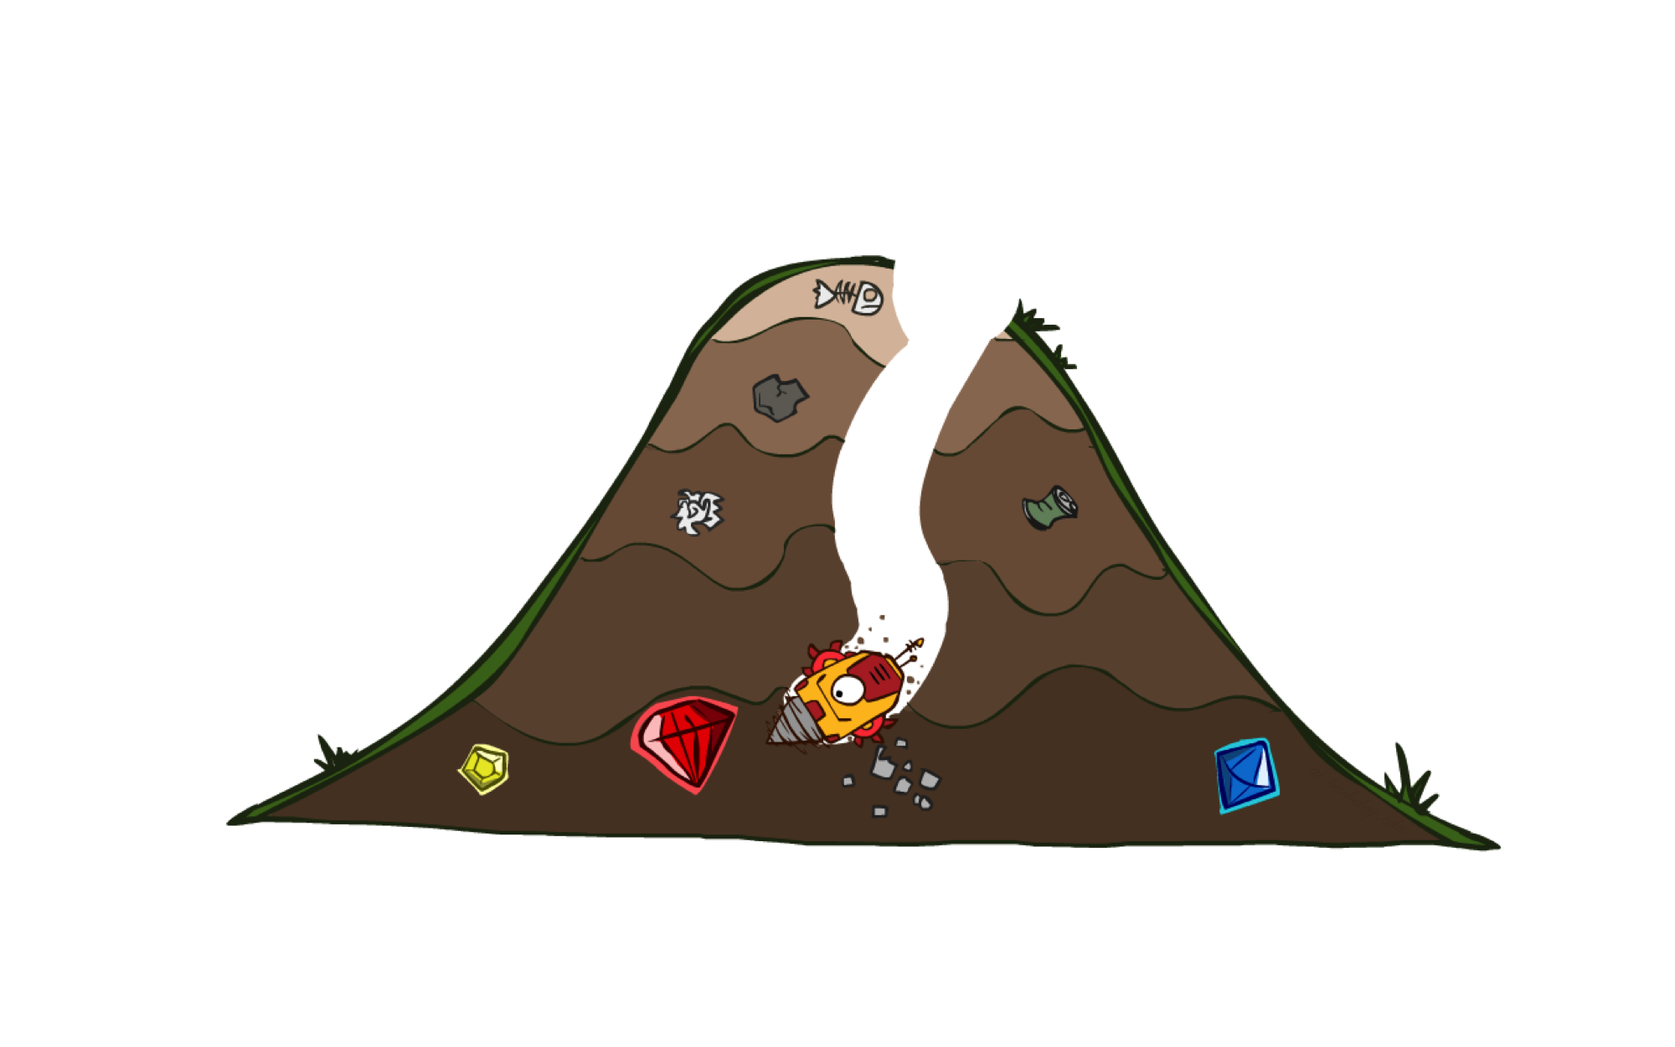
A* Search
Strategy: expand the node with the lowest sum of path cost and estimated cost.

Slide 19

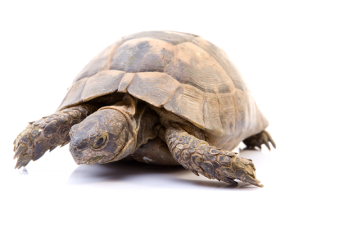

A* Search
UCS
Greedy
A*
Notes:
Notes: these images licensed from iStockphoto for UC Berkeley use.

Slide 20
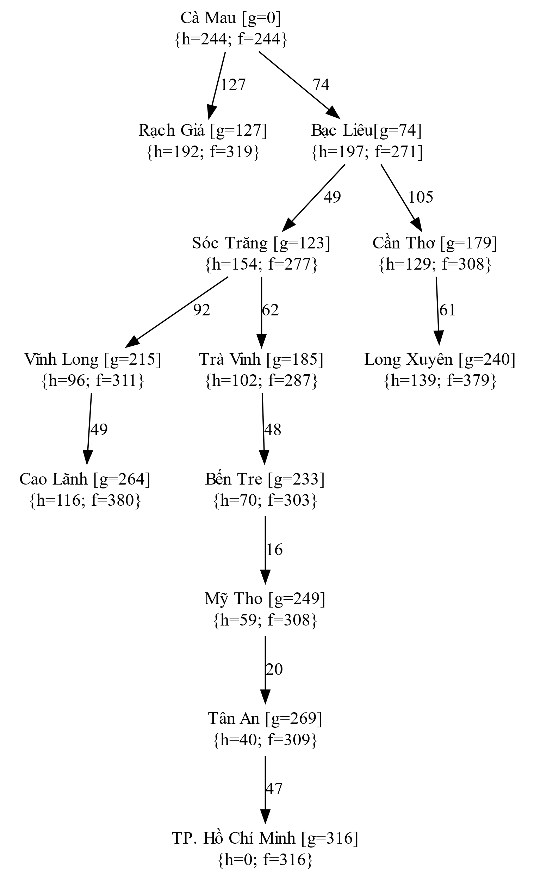
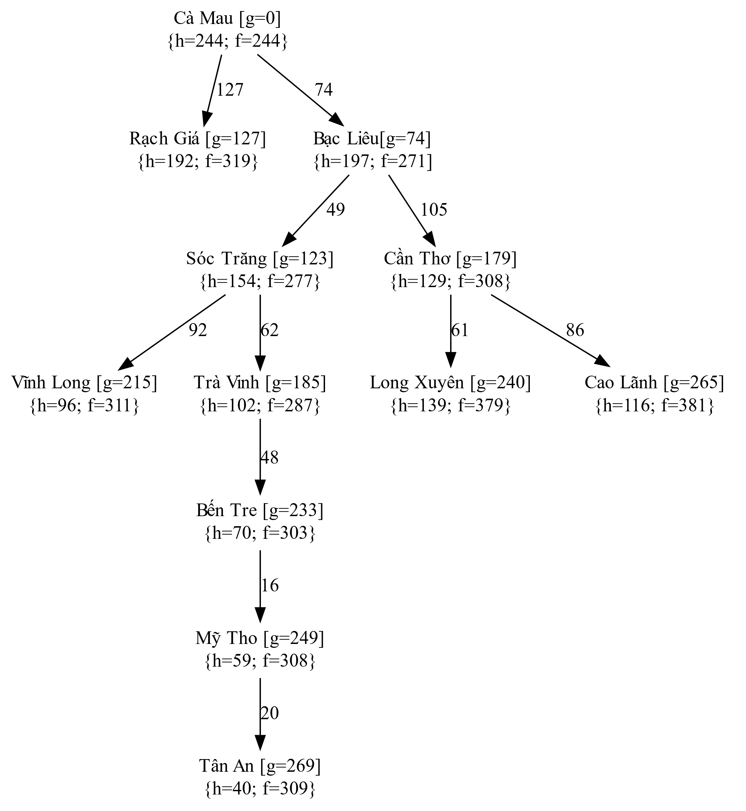
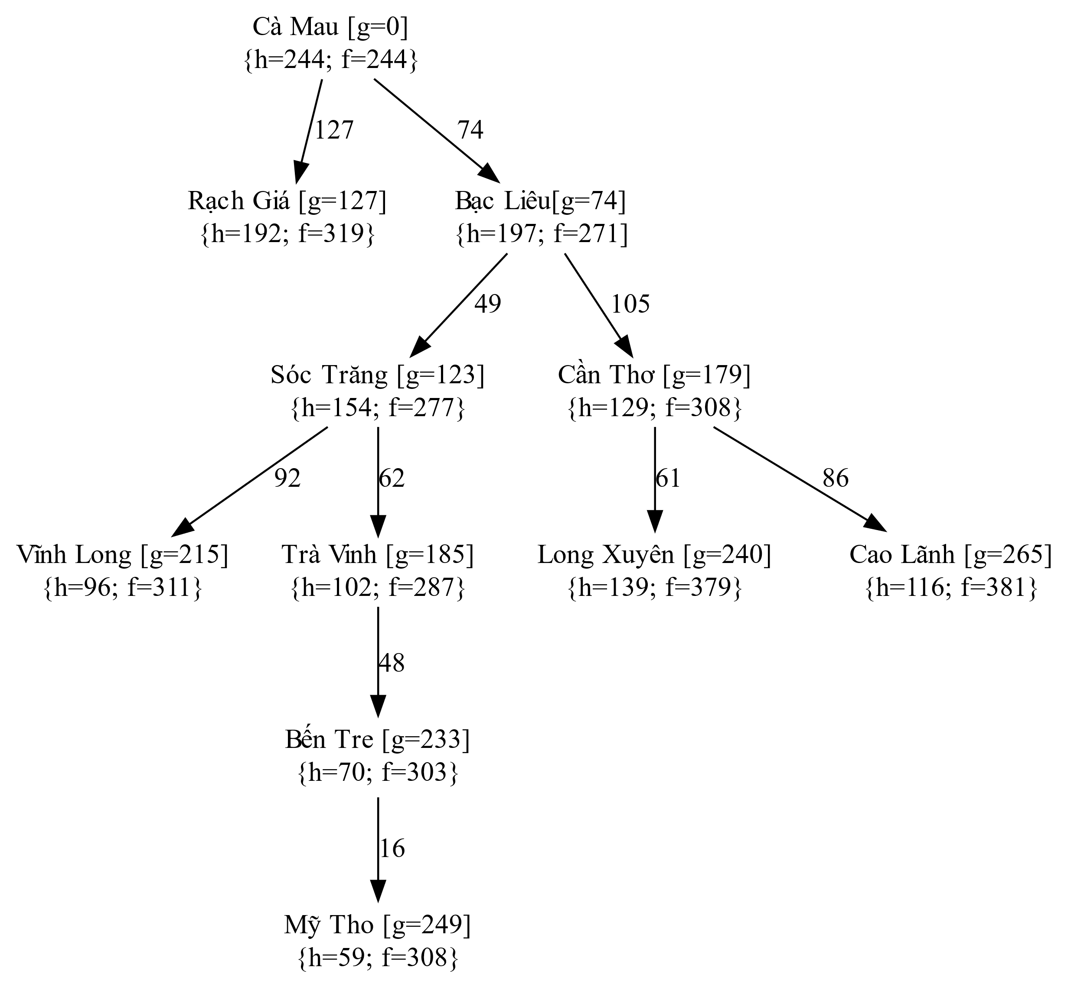
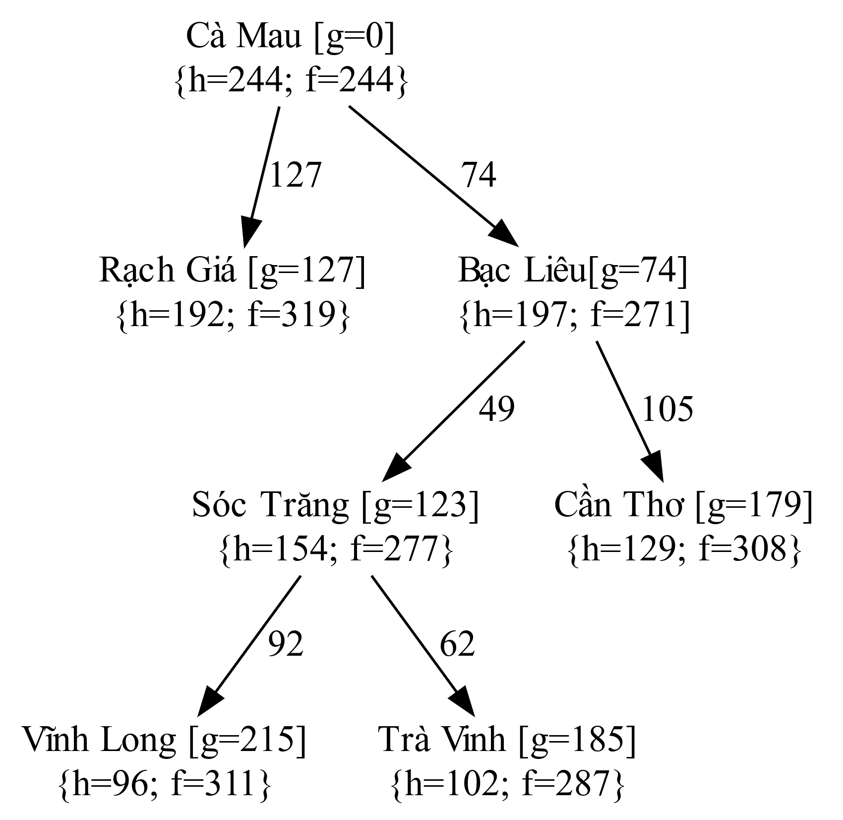
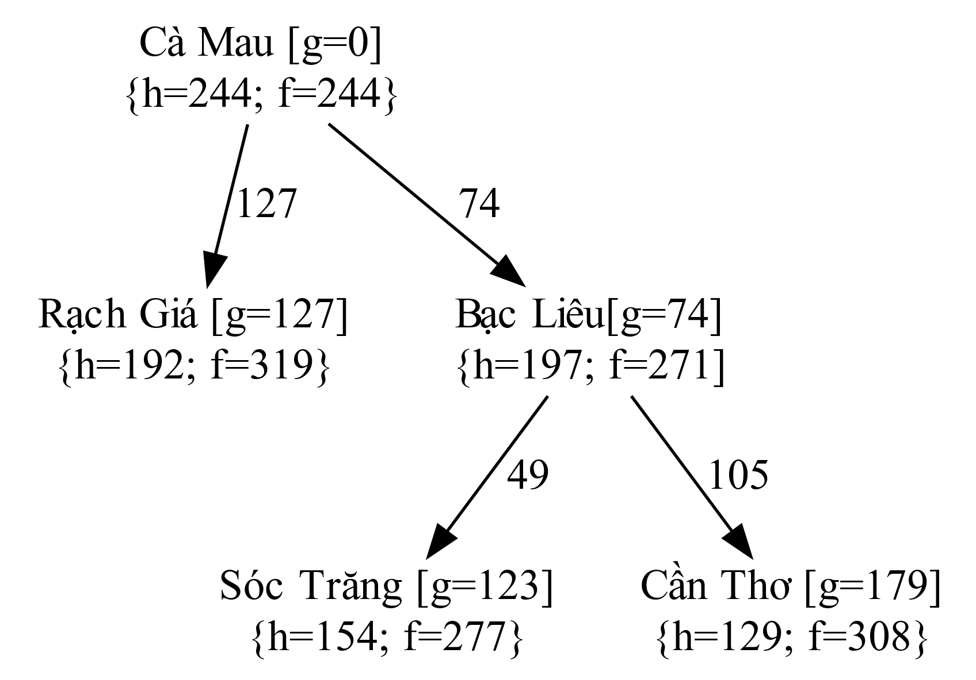
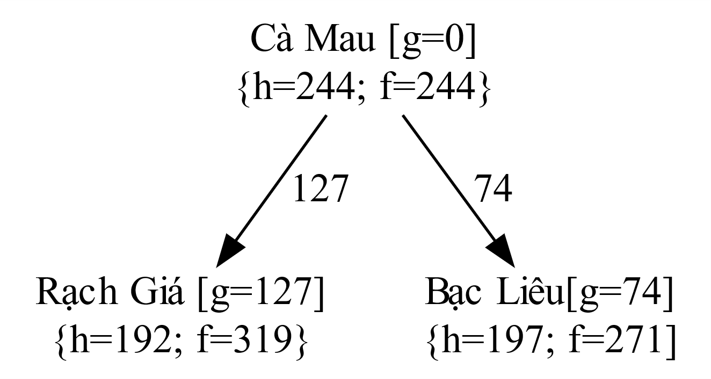
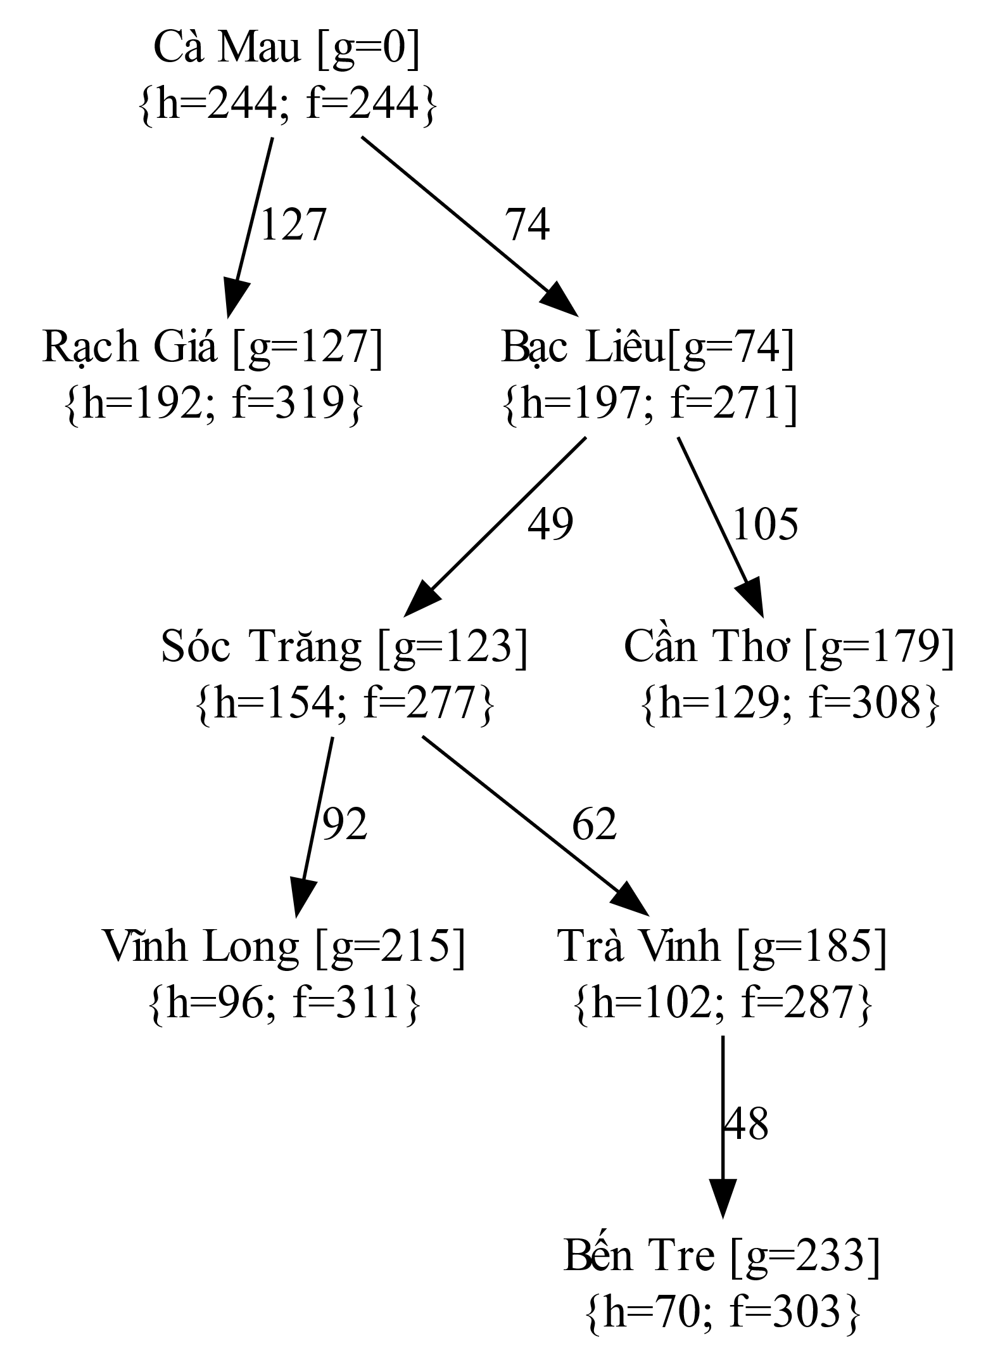
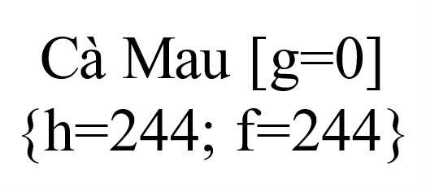
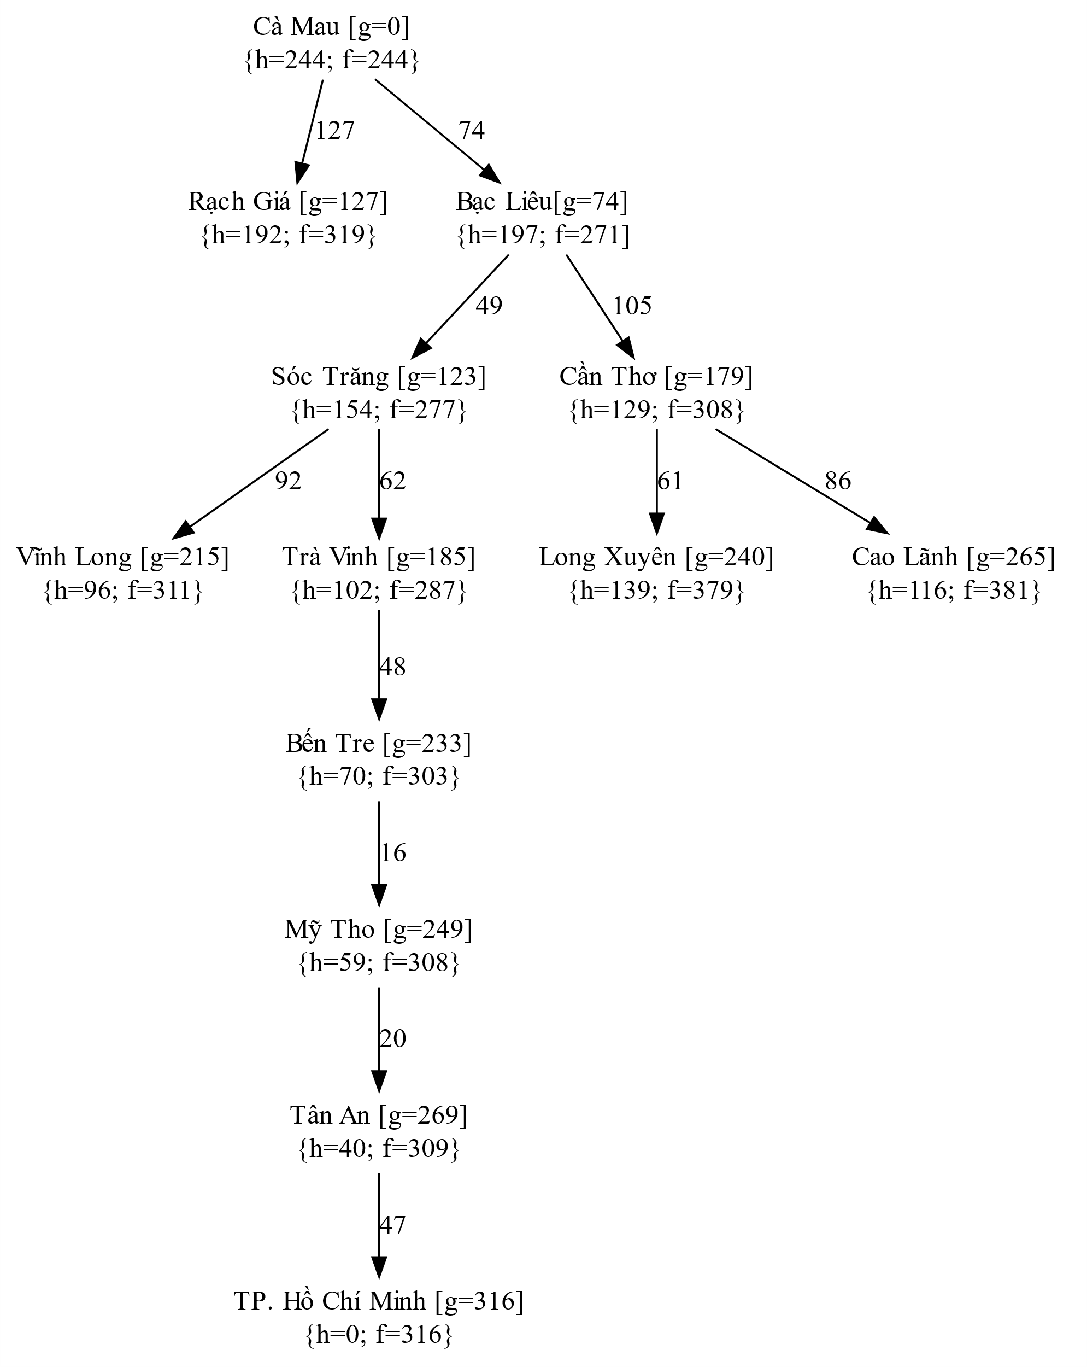
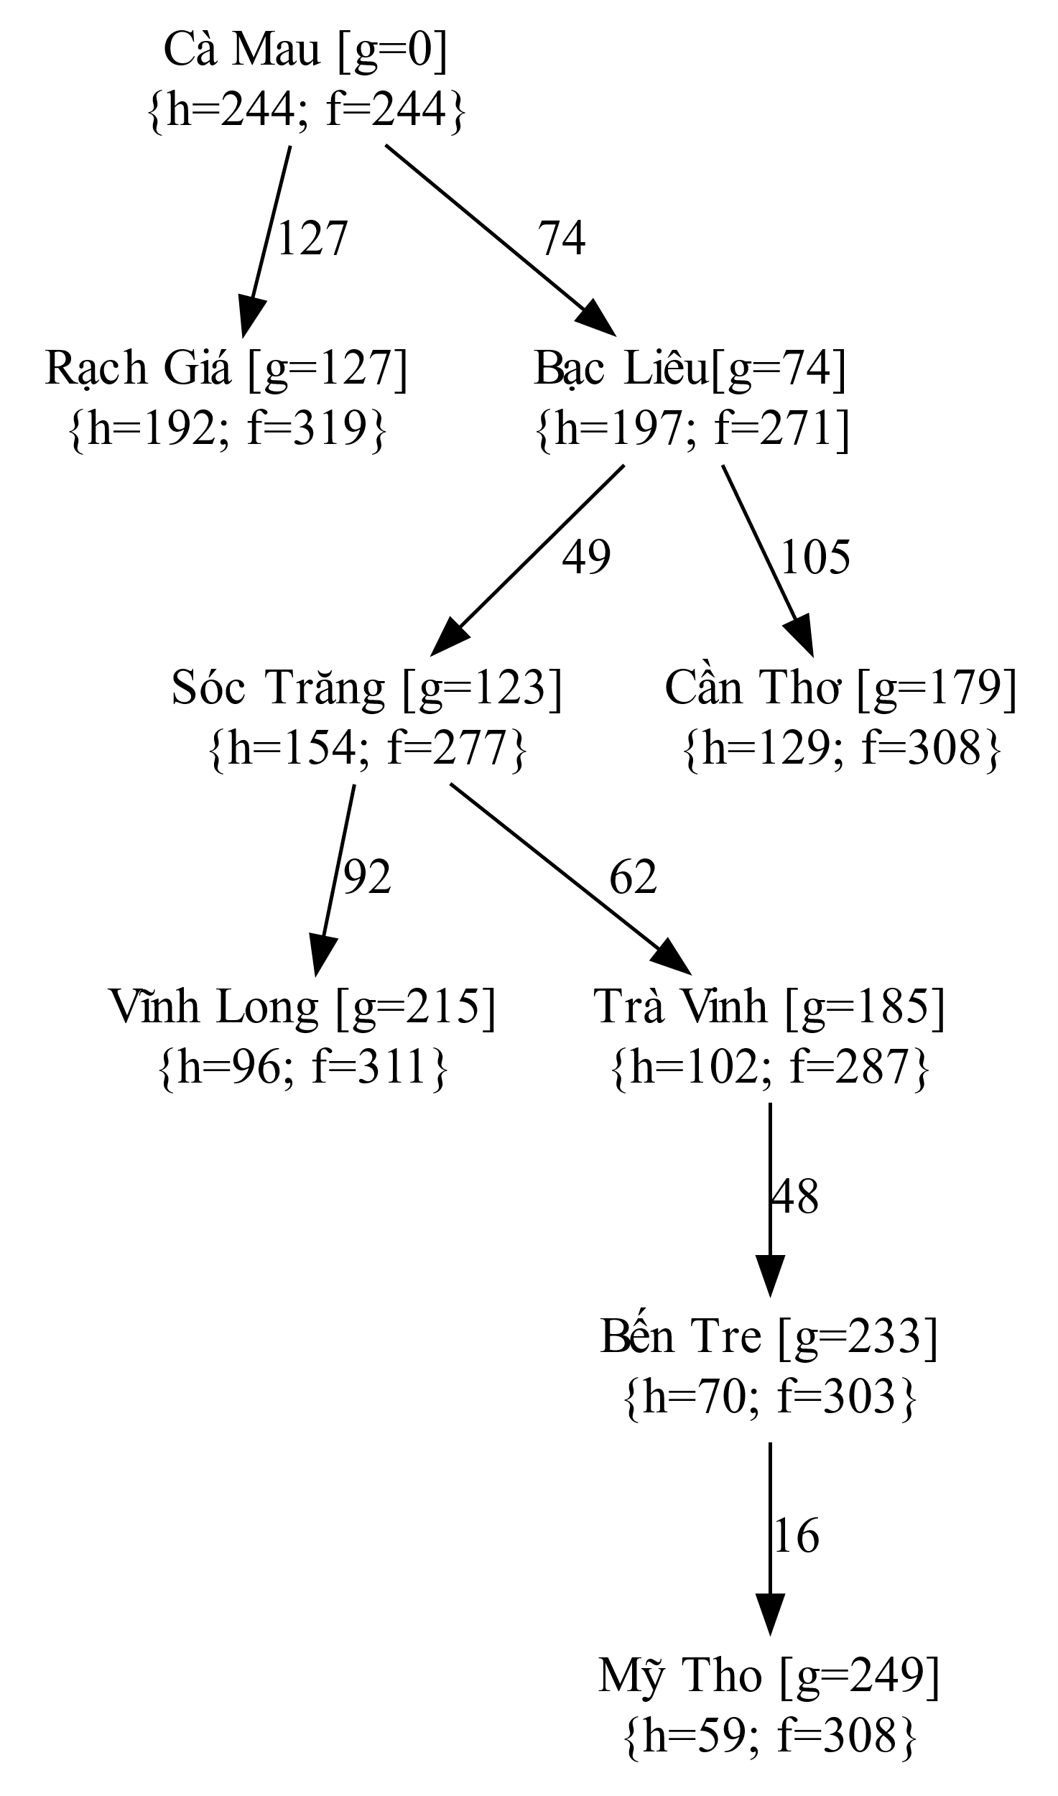
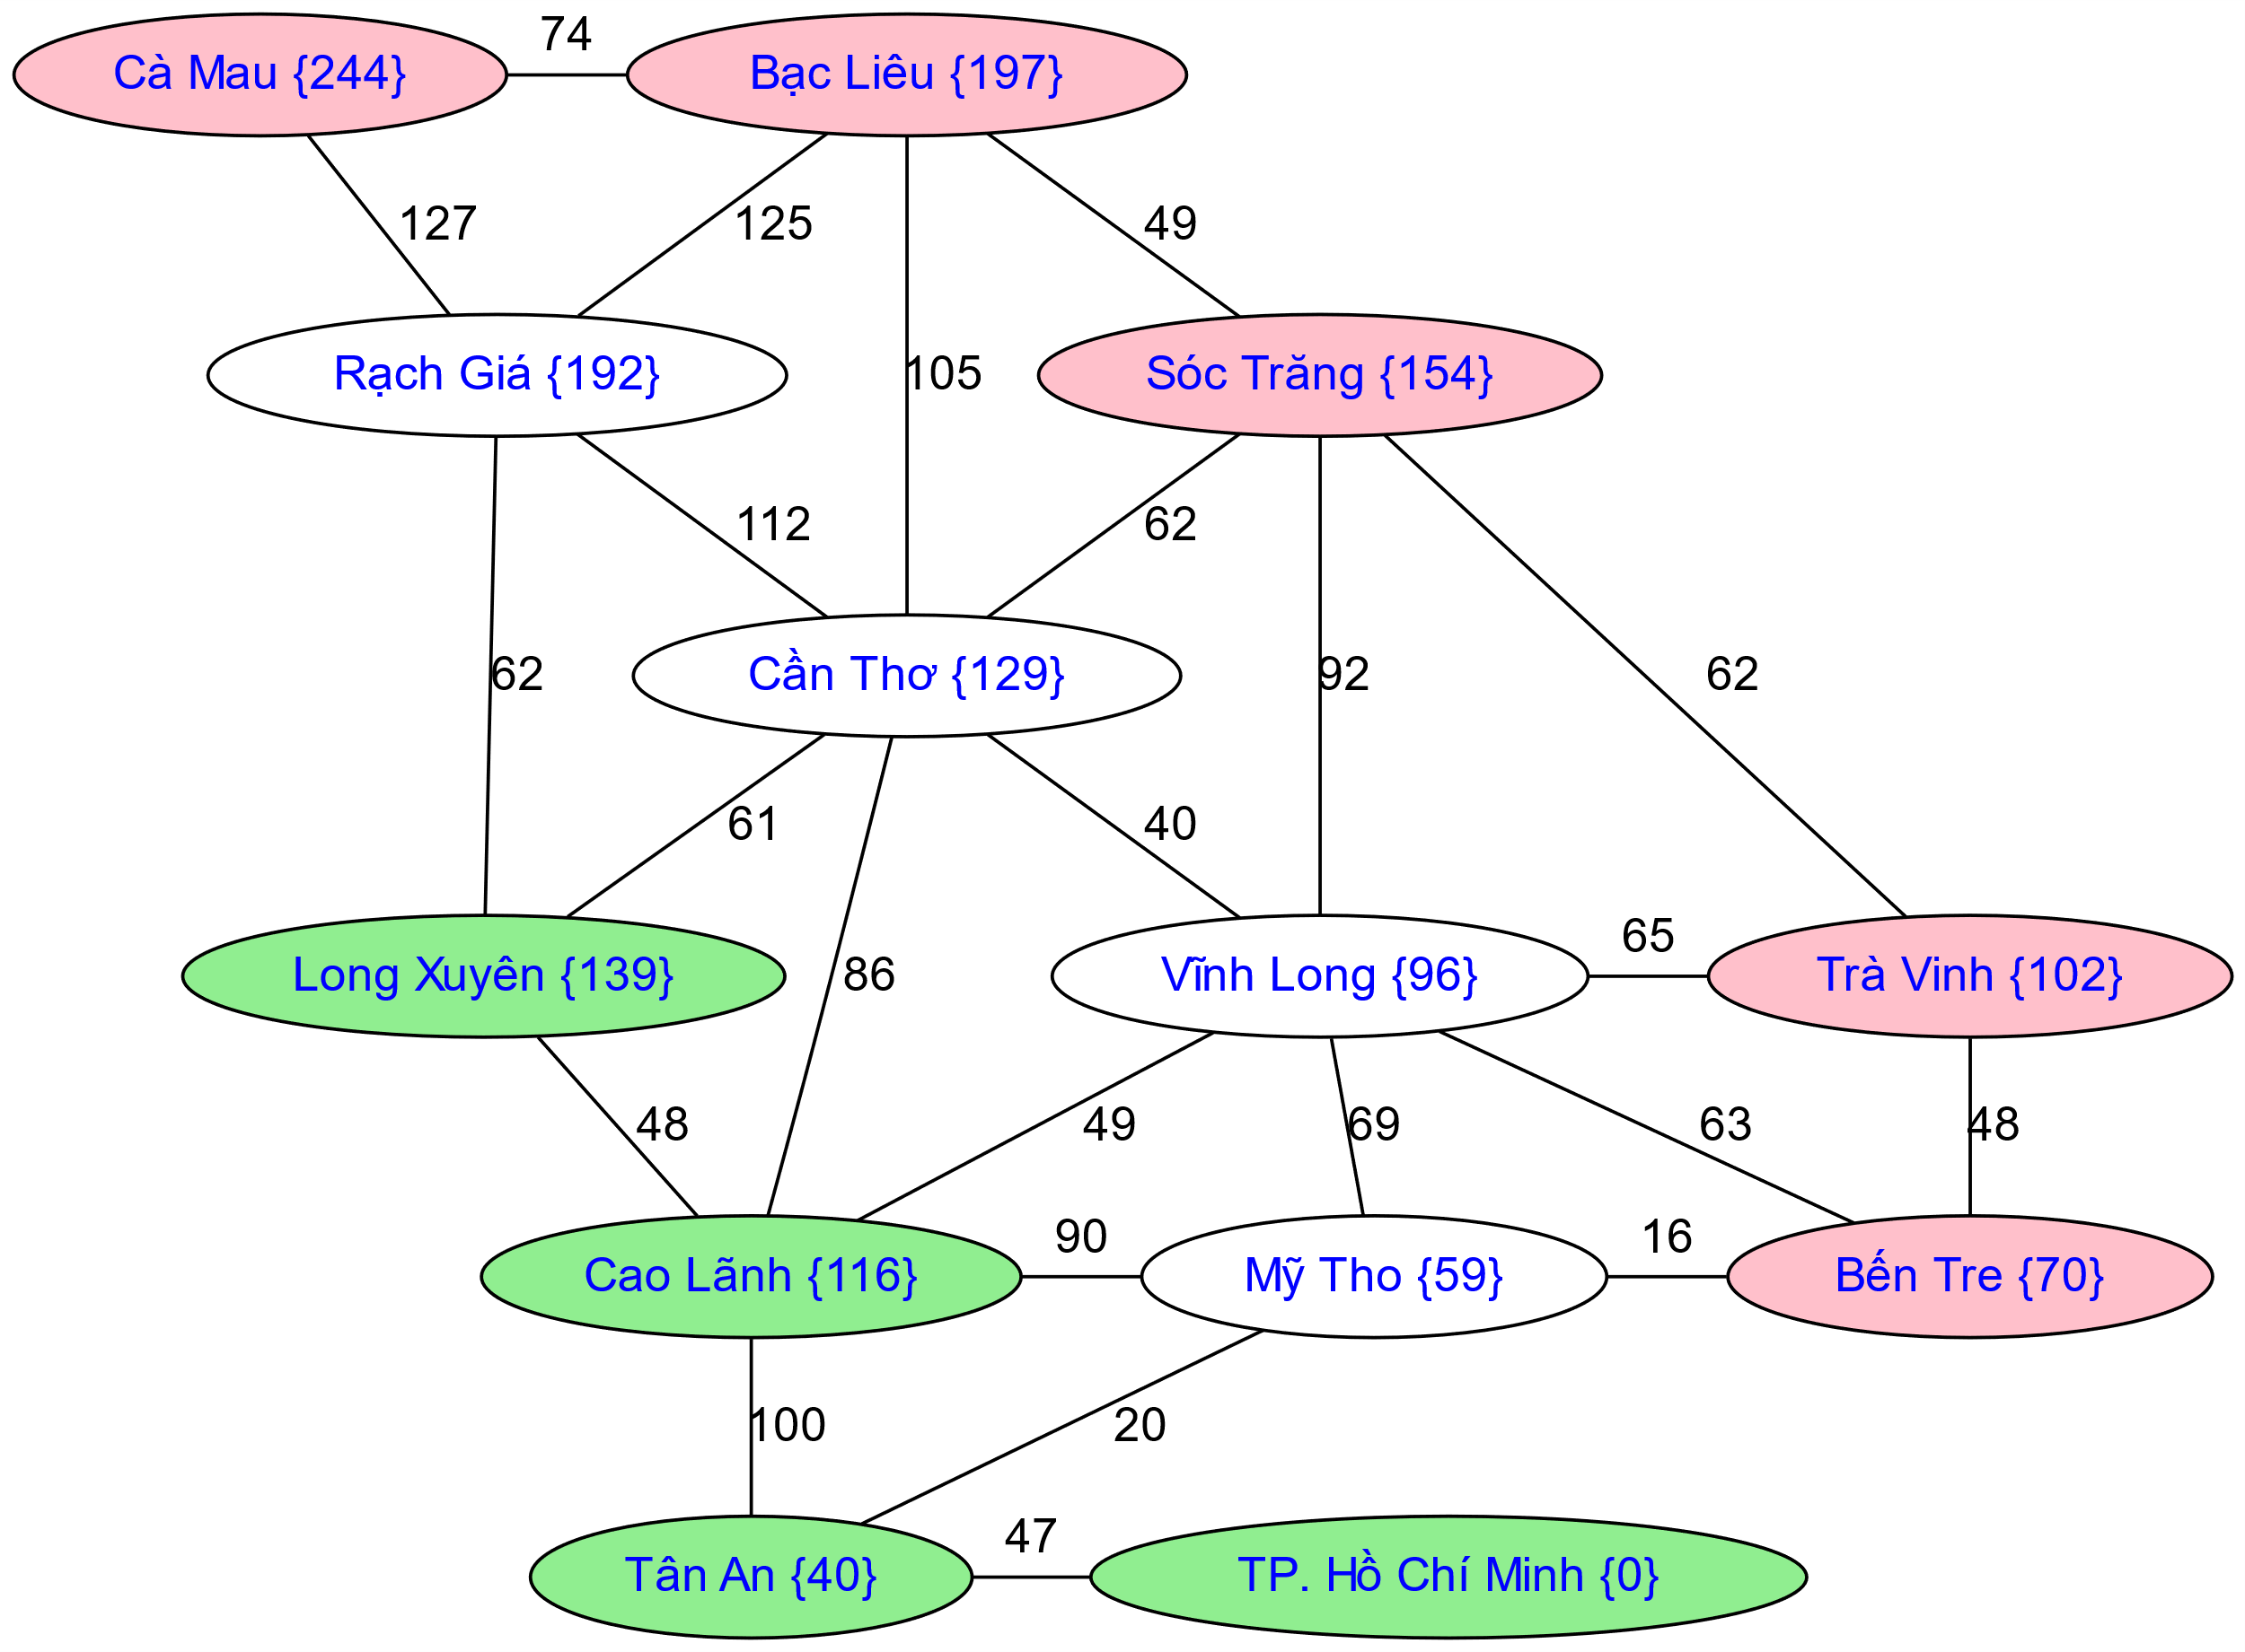
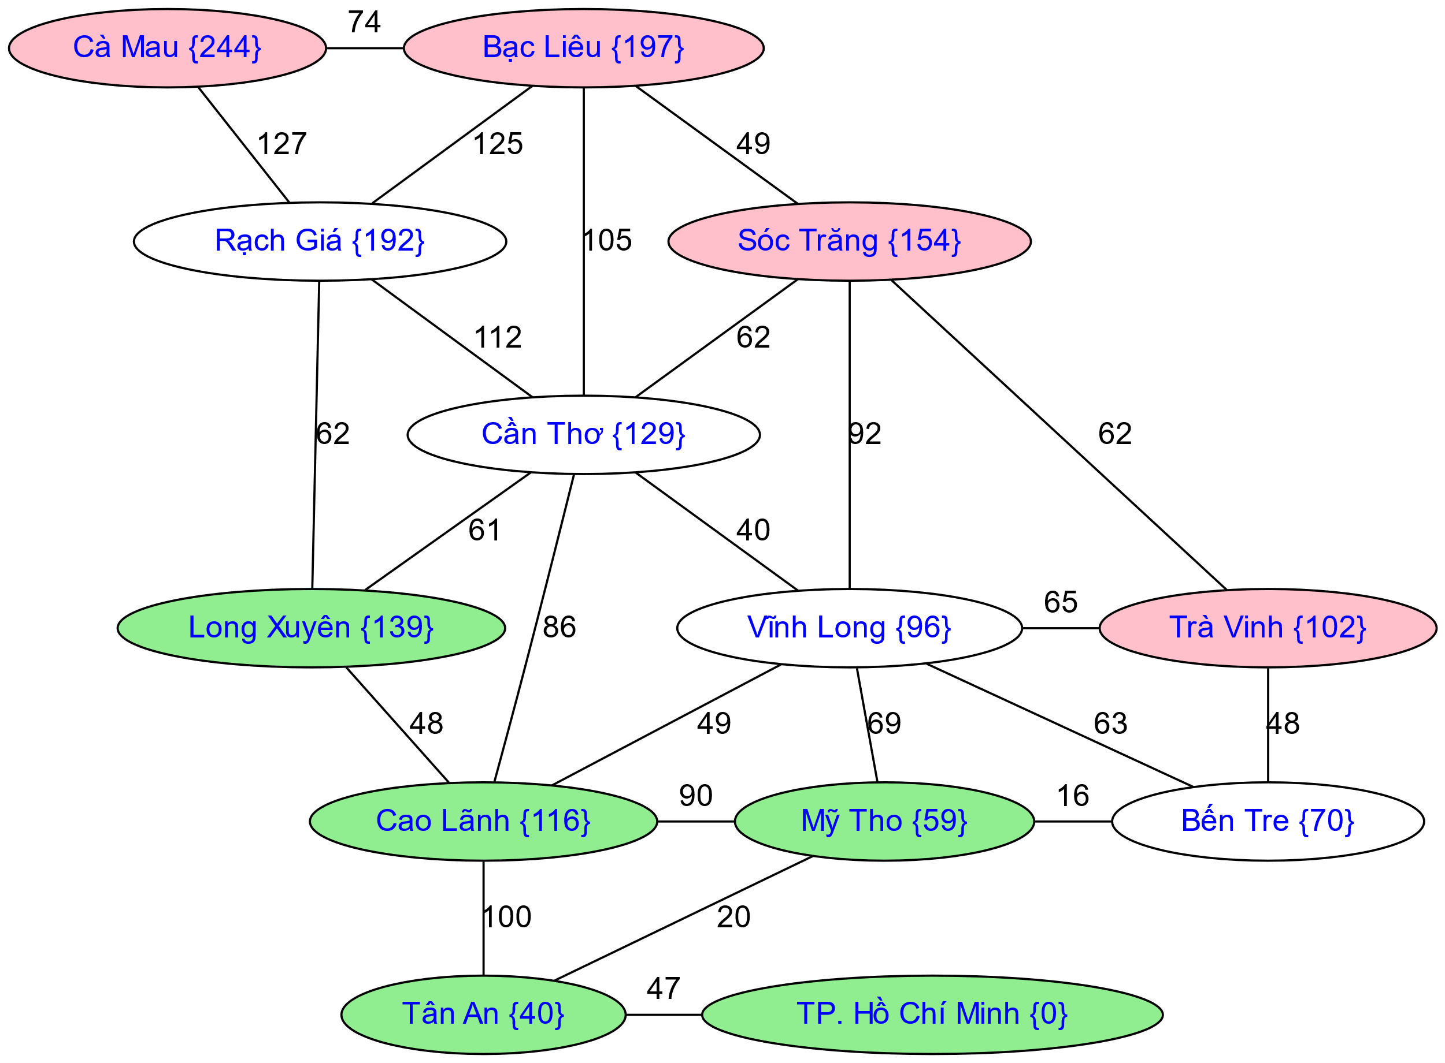
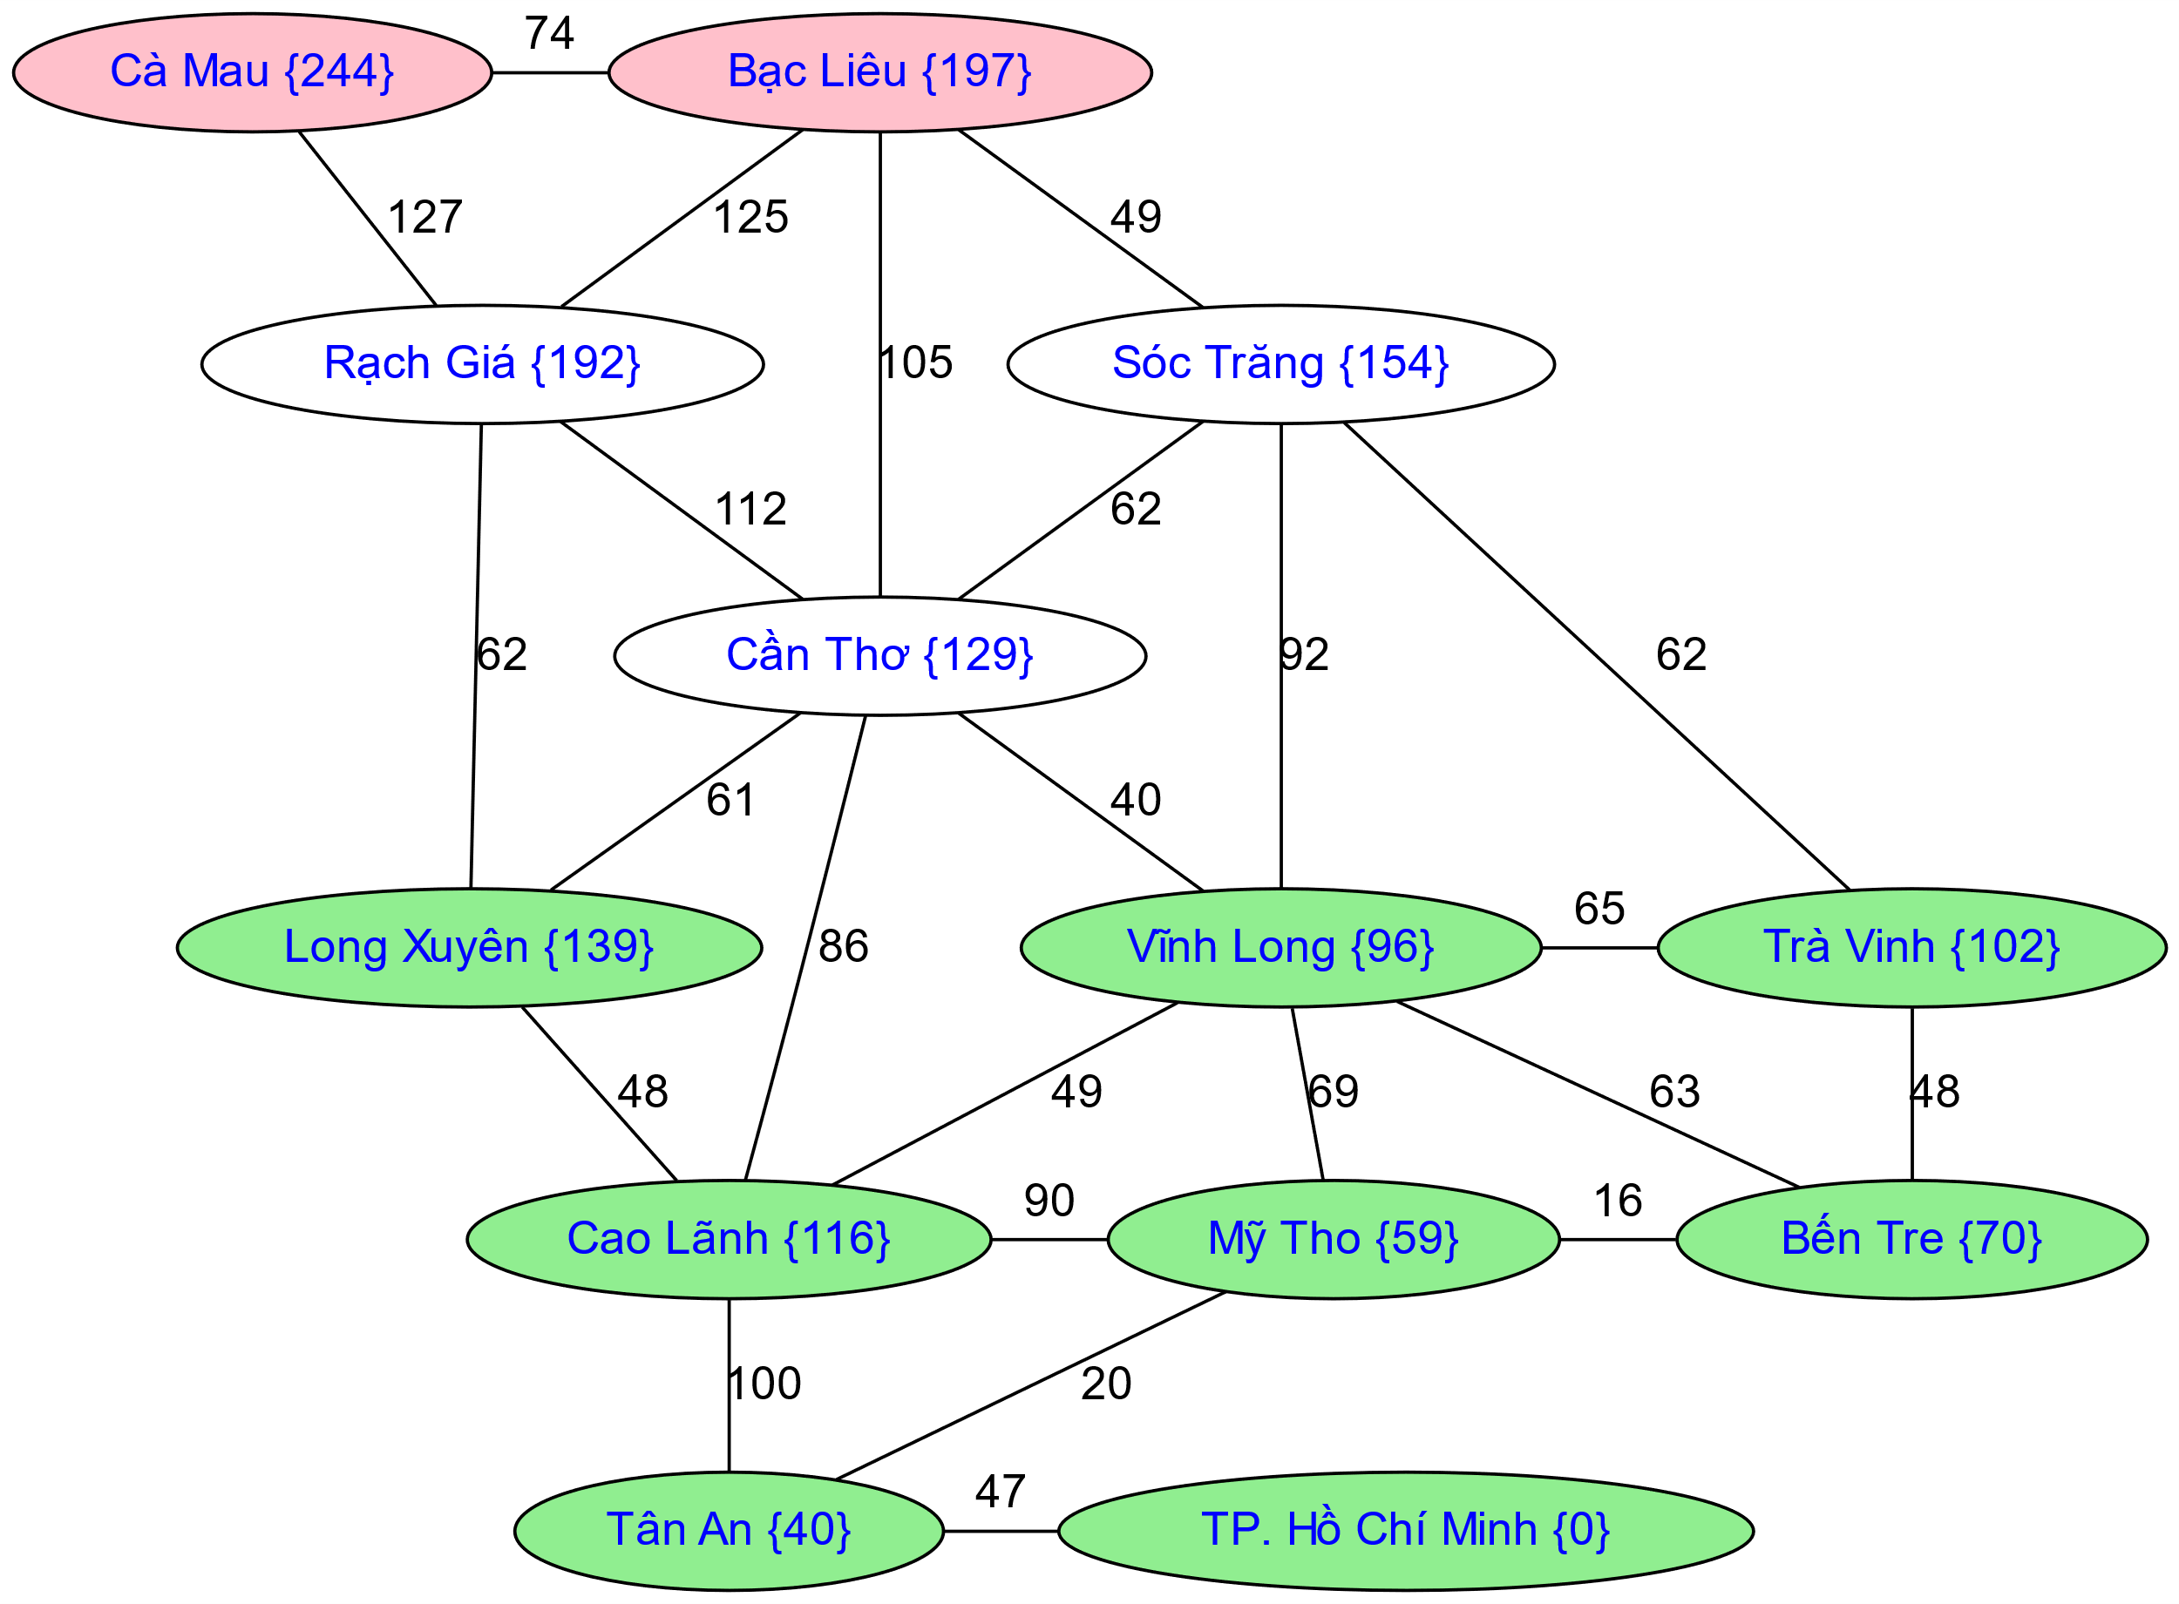
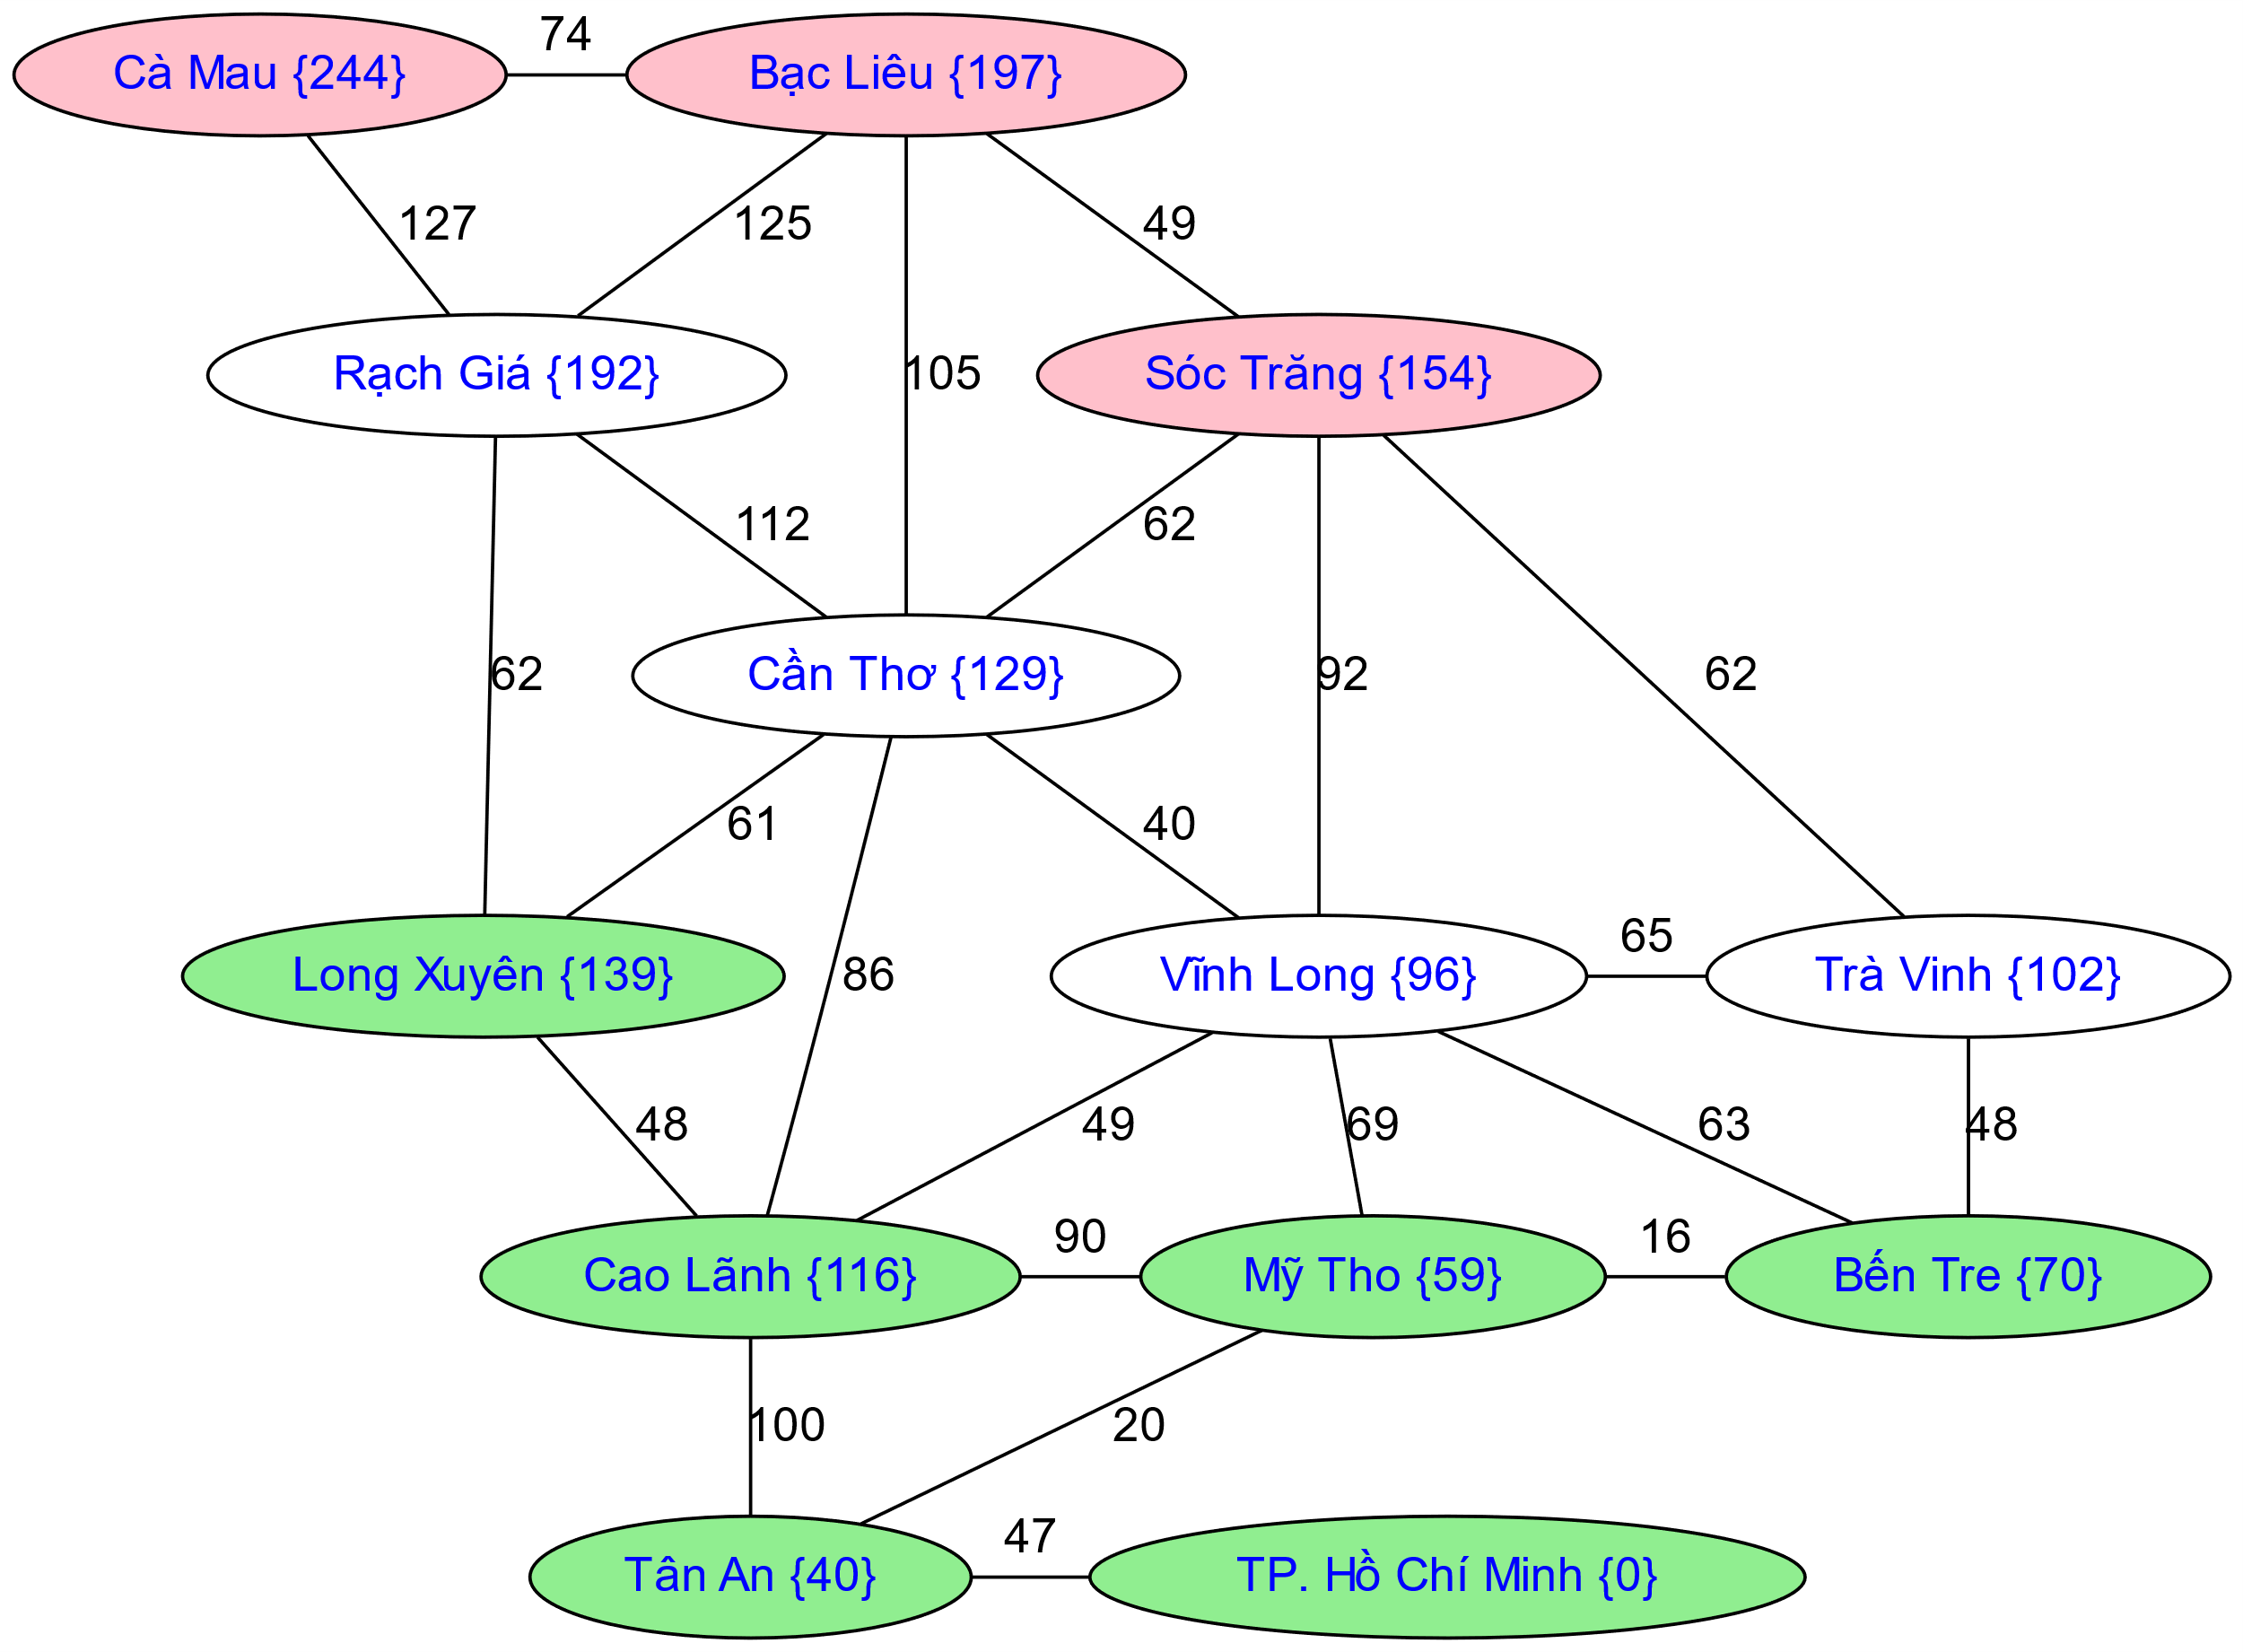
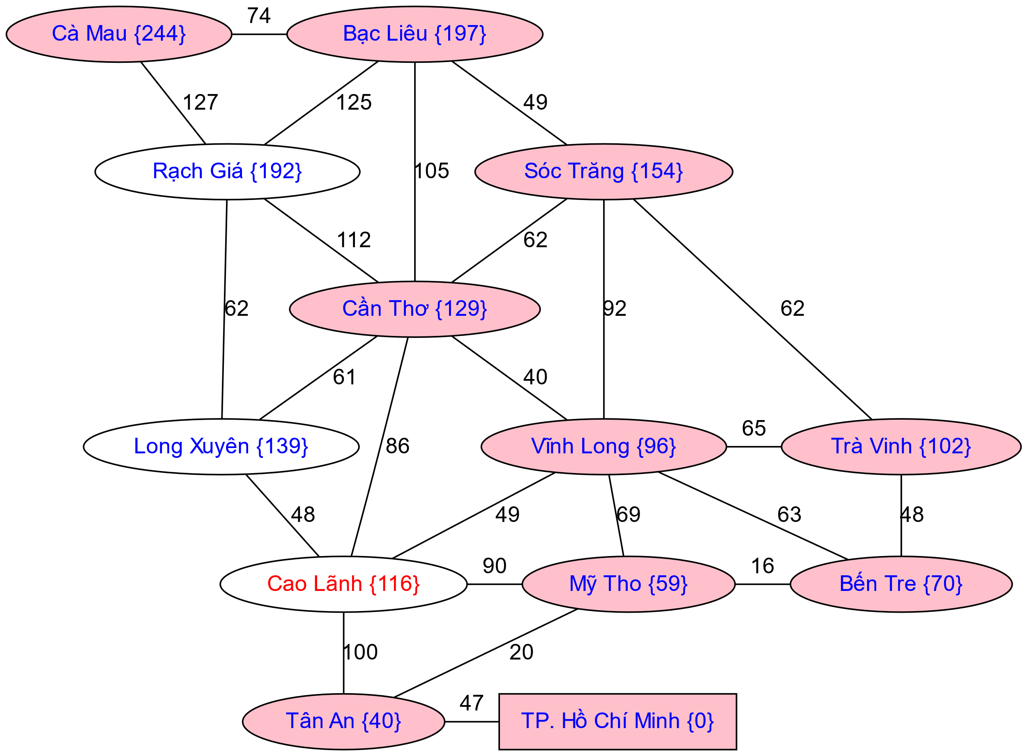
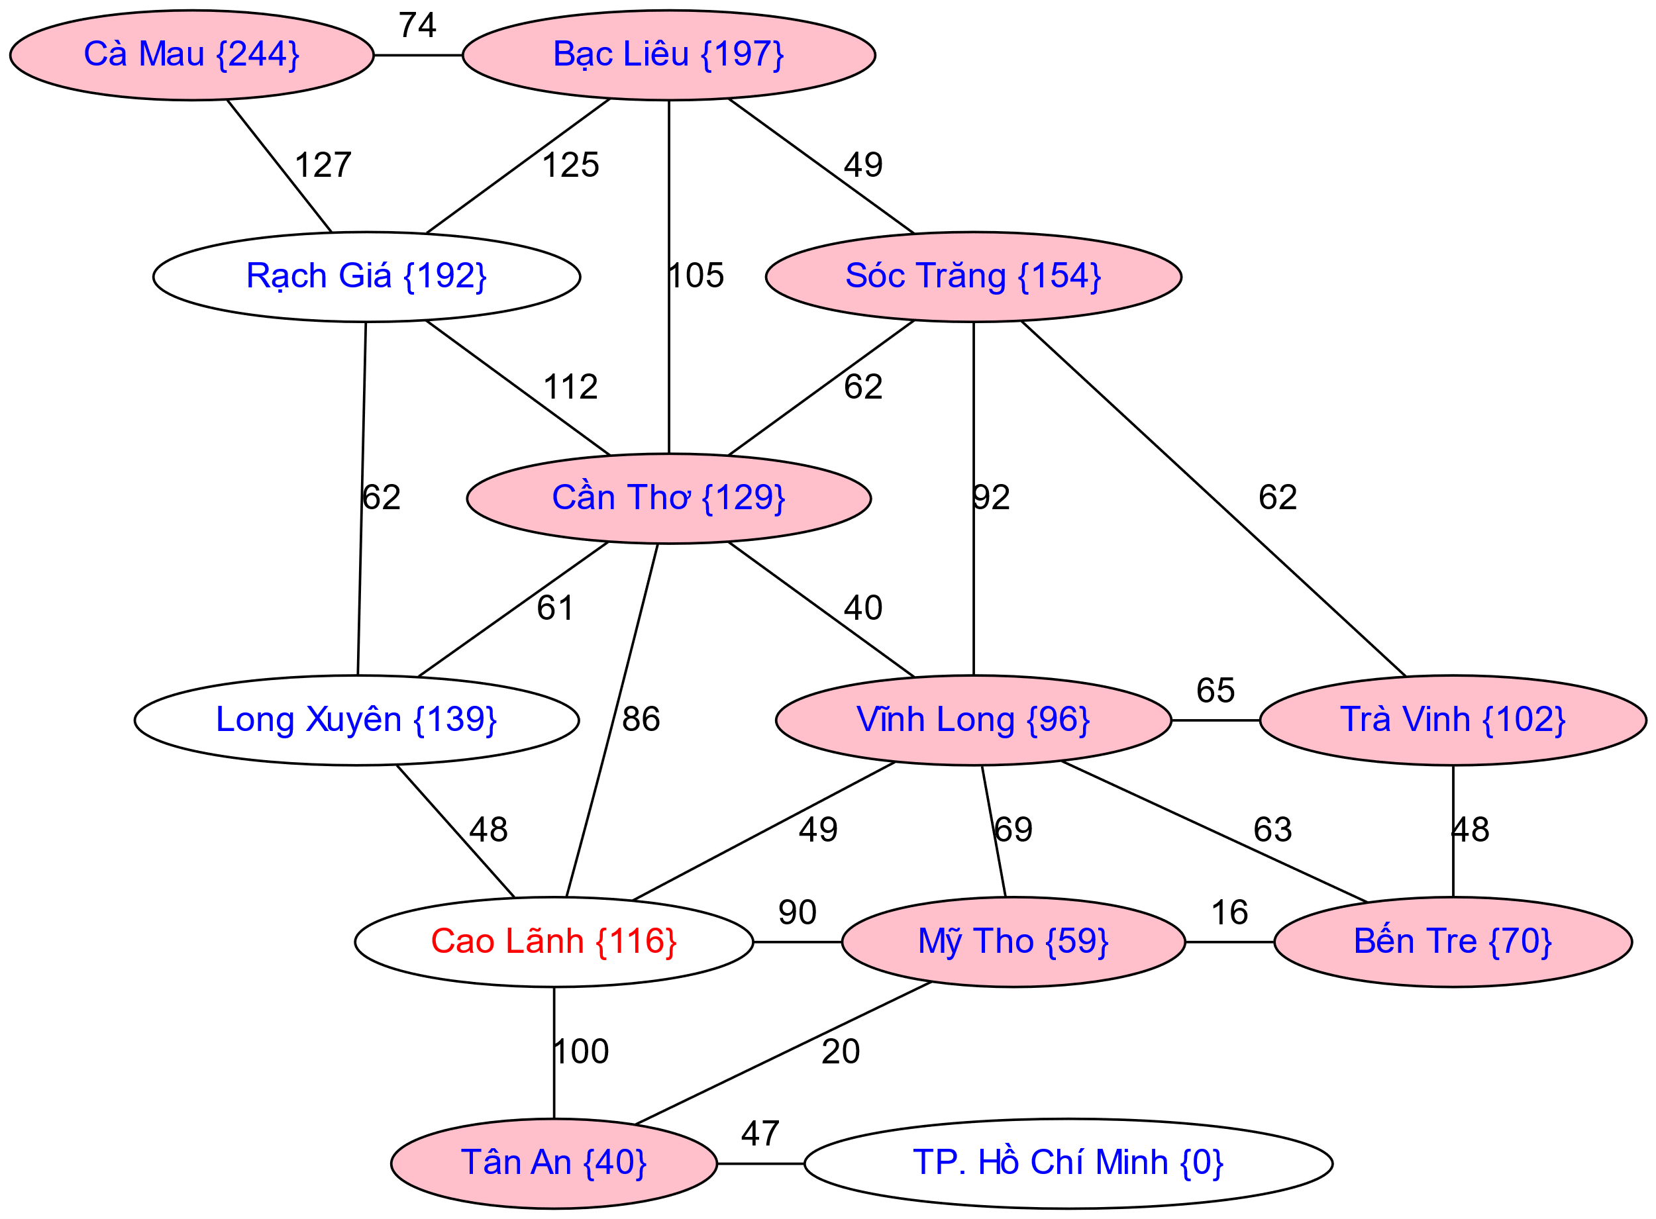
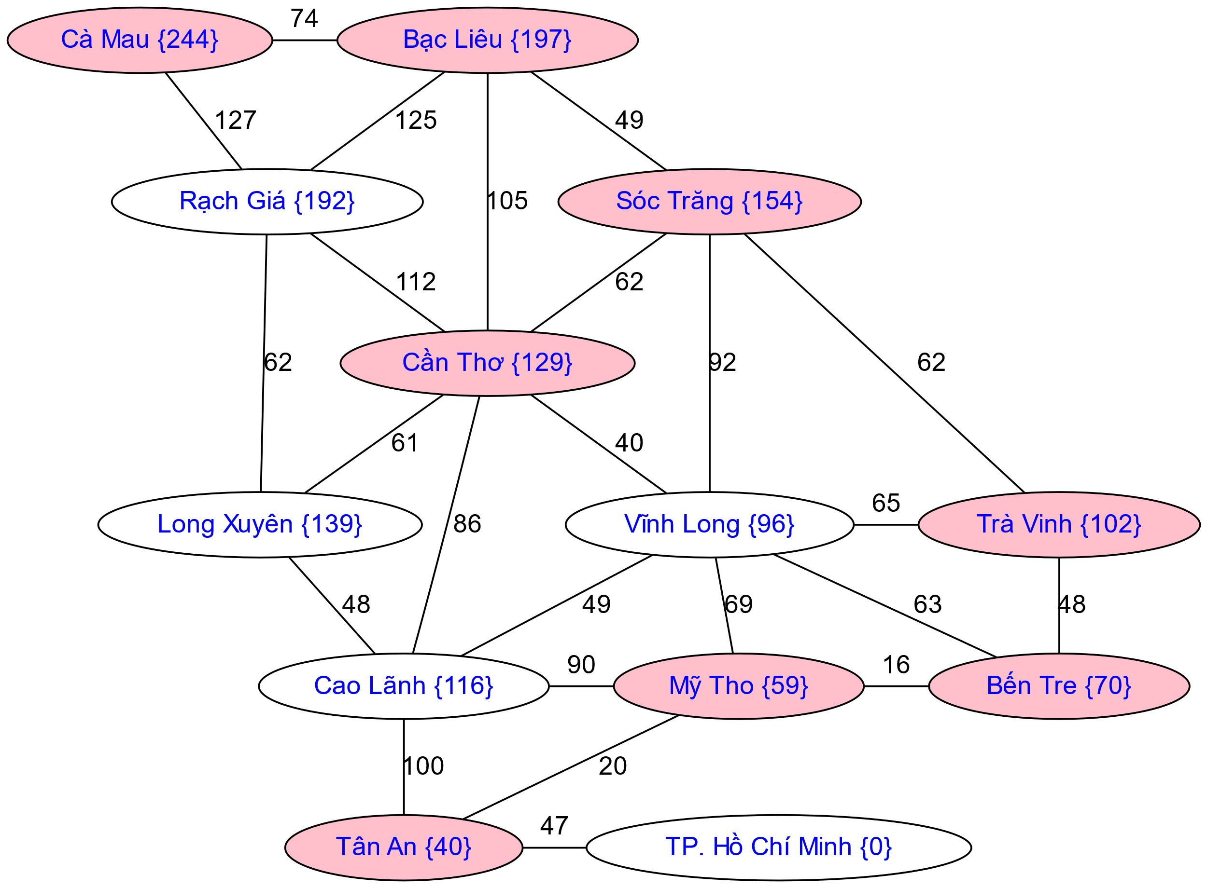
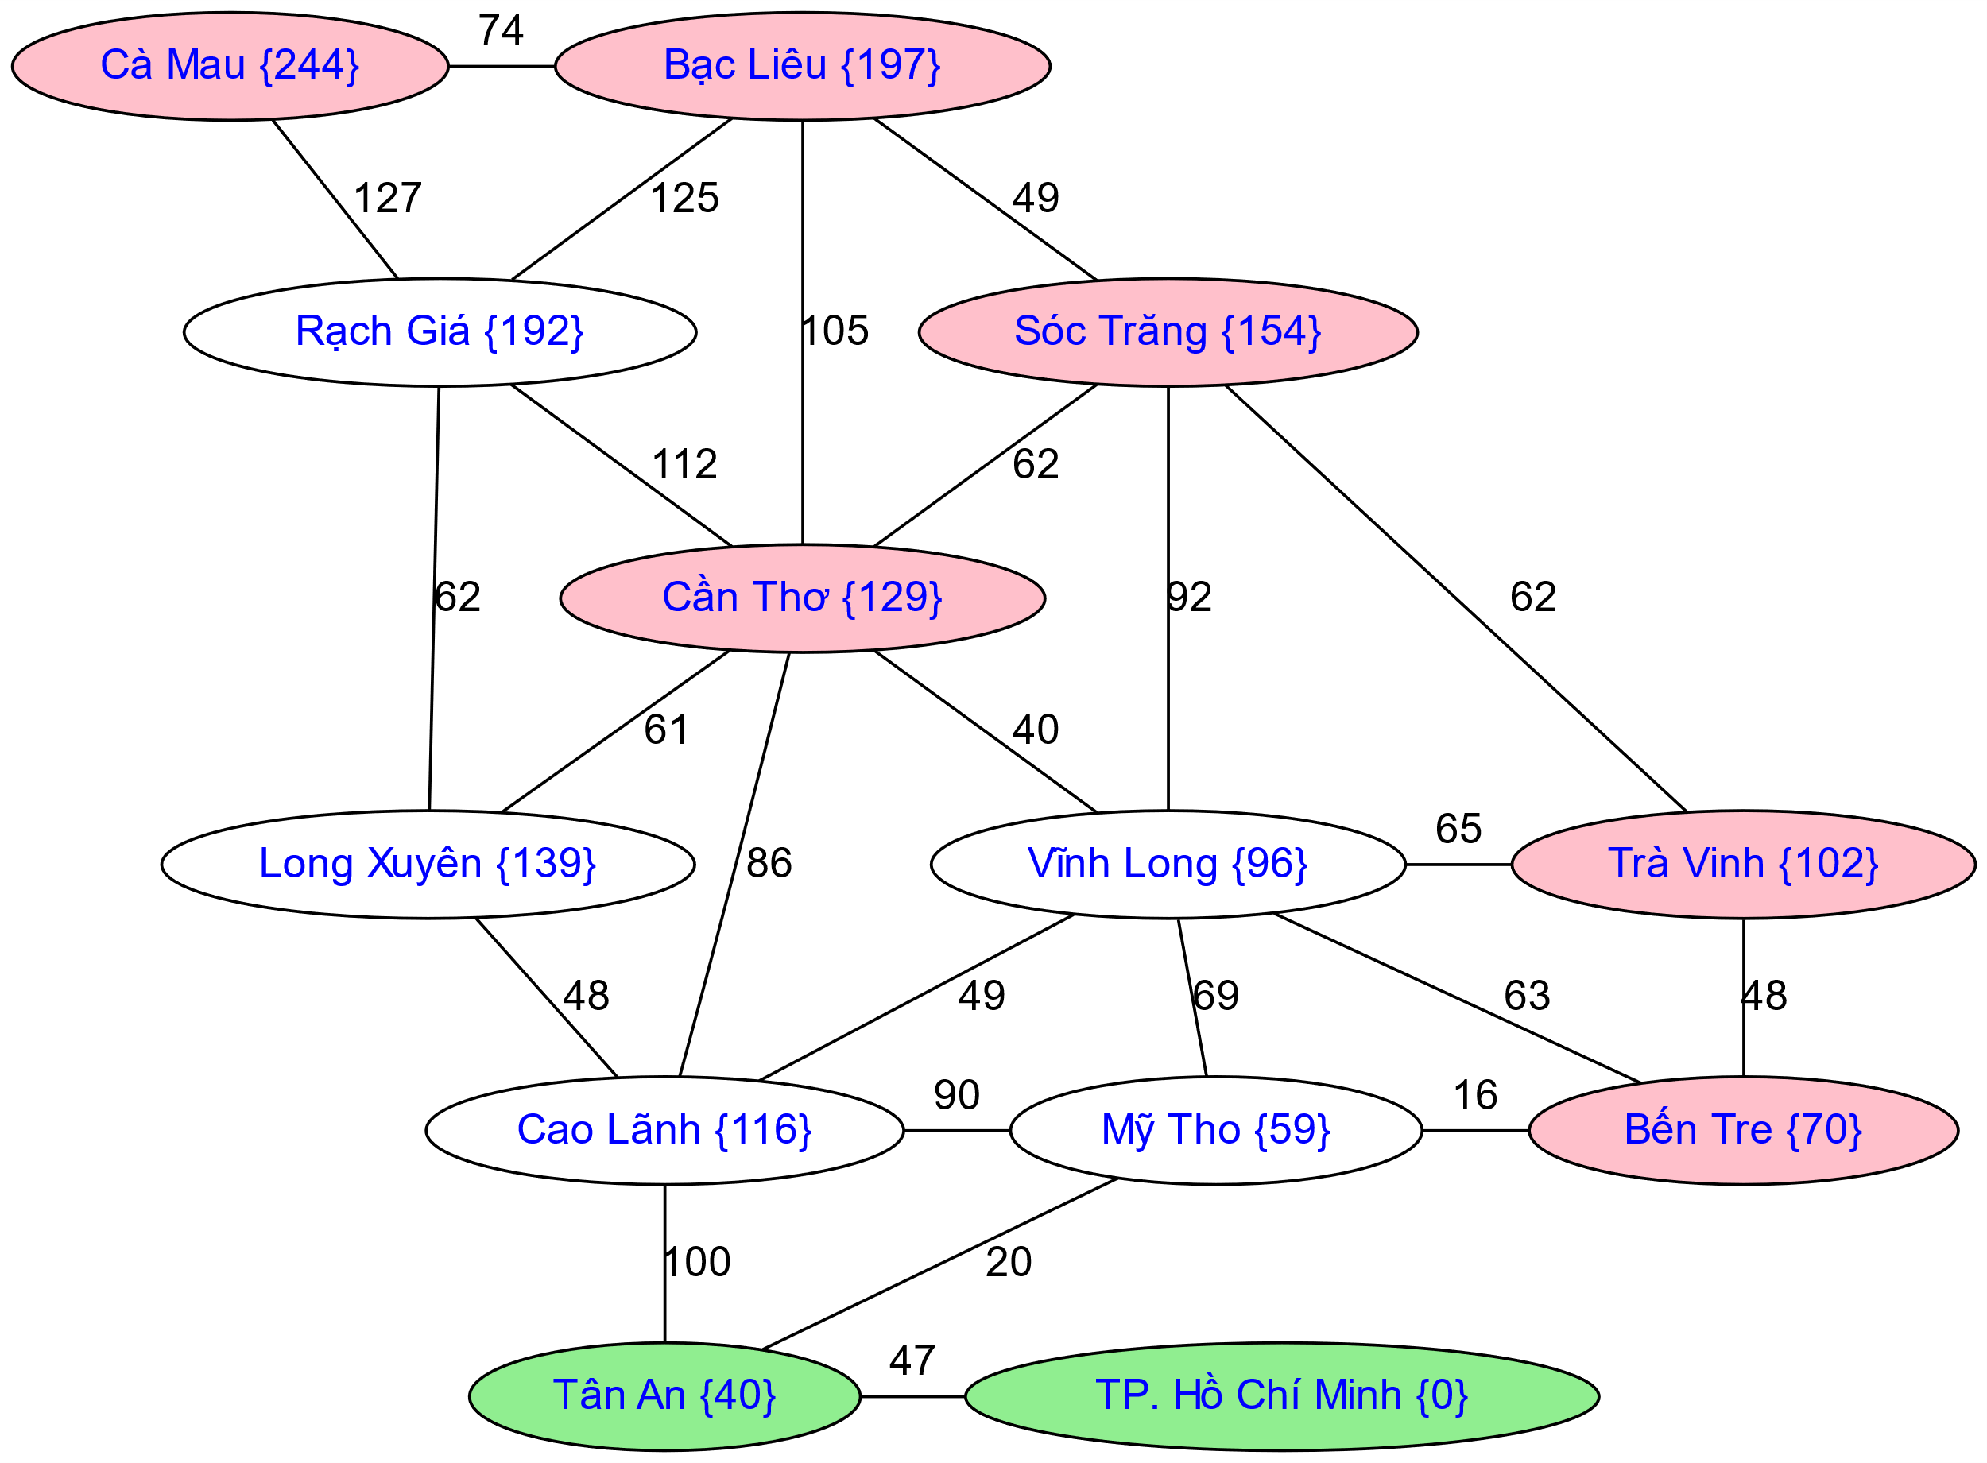
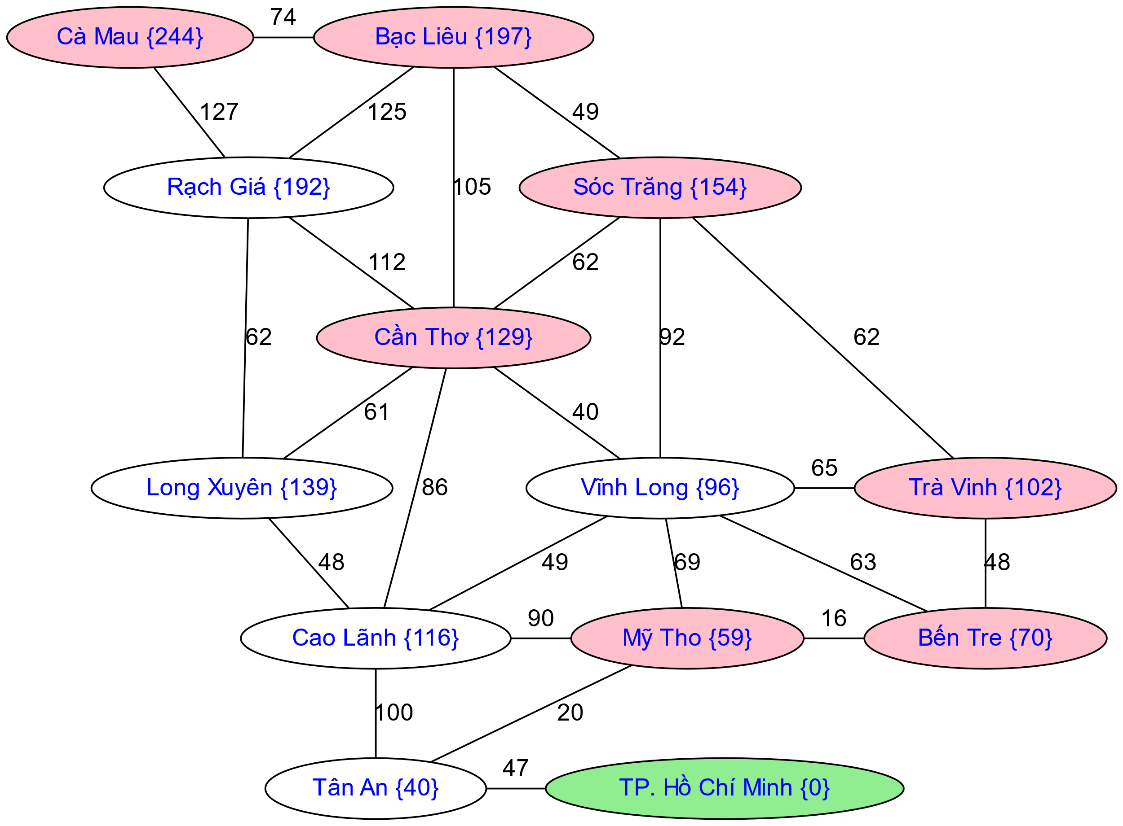
A* Search
Notes:
Notes: these images licensed from iStockphoto for UC Berkeley use.

Slide 21

Optimality of A* Tree Search

Slide 22
When should A* terminate?
Should we stop when we enqueue a goal?
No: only stop when we dequeue a goal
h = 2
A
2
2
S
h = 3
h = 0
G
2
B
3
h = 1

Slide 23
Is A* Optimal?
h = 6
1
A
3
S
h = 7
G
h = 0
5
What went wrong?
Actual bad goal cost < estimated good goal cost
We need estimates to be less than actual costs!

Slide 24

Admissible Heuristics

Slide 25

Idea: Admissibility
Inadmissible (pessimistic) heuristics break optimality by trapping good plans on the fringe
Admissible (optimistic) heuristics slow down bad plans but never outweigh true costs

Slide 26


Admissible Heuristics
A heuristic h is admissible (optimistic) if:
where is the true cost to a nearest goal
Example:
Coming up with admissible heuristics is most of what’s involved in using A* in practice.
15

Slide 27
A* Graph Search Gone Wrong?
State space graph
Search tree
A
S (0+2)
1
S
1
C
h=4
h=1
A (1+4)
B (1+1)
h=2
1
2
B
3
C (2+1)
C (3+1)
h=1
G
G (5+0)
G (6+0)
h=0

Slide 28
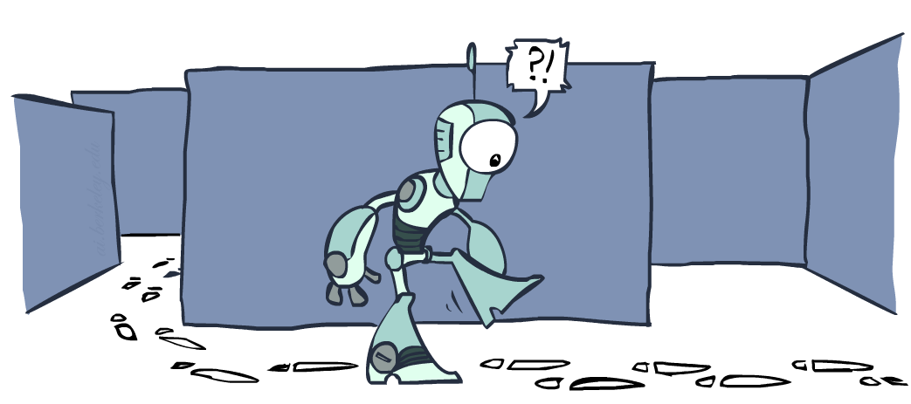
Tree Search versus Graph Search

Slide 29
Tree Search: Extra Work!
Failure to detect repeated states can cause exponentially more work.
State Graph
Search Tree

Slide 30
Tree Search versus Graph Search
In BFS, for example, we shouldn’t bother expanding the circled nodes (why?)
S
d
e
p
b
c
e
h
r
q
a
a
h
r
p
q
f
p
q
f
q
c
G
q
c
G
a
a

Slide 31
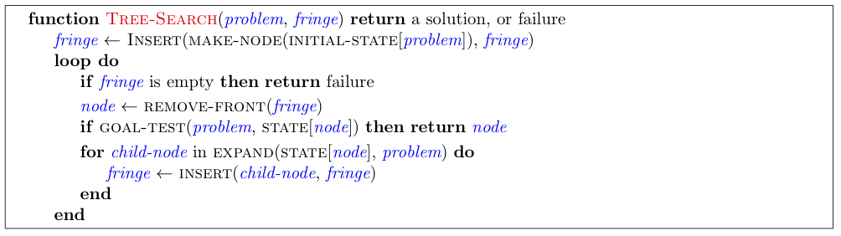
Tree Search Pseudo-Code

Slide 32
Graph Search Pseudo-Code

Slide 33
Graph Search
Idea: never expand a state twice
How to implement:
Tree search + set of expanded states (“closed set”)
Expand the search tree node-by-node, but…
Before expanding a node, check to make sure its state has never been expanded before
If not new, skip it, if new add to closed set
Important: store the closed set as a set, not a list
Can graph search wreck completeness? Why/why not?
How about optimality?

Slide 34
A* Graph Search Gone Wrong?
State space graph
Search tree
A
S (0+2)
1
S
1
C
h=4
h=1
A (1+4)
B (1+1)
h=2
1
2
B
3
C (2+1)
C (3+1)
h=1
G
G (5+0)
G (6+0)
h=0

Slide 35
Consistency of Heuristics
Main idea: estimated heuristic costs ≤ actual costs
Admissibility: heuristic cost ≤ actual cost to goal
h(A) ≤ actual cost from A to G
Consistency: heuristic “arc” cost ≤ actual cost for each arc
h(A) – h(C) ≤ cost(A to C)
Consequences of consistency:
The f value along a path never decreases
h(A) ≤ cost(A to C) + h(C)
A* graph search is optimal
A
1
C
h=4
h=1
h=2
3
G

Slide 36
Optimality
Tree search:
A* is optimal if heuristic is admissible
UCS is a special case (h = 0)
Graph search:
A* optimal if heuristic is consistent
UCS optimal (h = 0 is consistent)
Consistency implies admissibility
In general, most natural admissible heuristics tend to be consistent, especially if from relaxed problems

Slide 37
Properties of A*

Slide 38
Properties of A*
Uniform-Cost
A*
b
b
…
…

Slide 39
UCS vs A* Contours
Uniform-cost expands equally in all “directions”
A* expands mainly toward the goal, but does hedge its bets to ensure optimality
Start
Goal
Start
Goal
[Demo: contours UCS / greedy / A* empty (L3D1)]
[Demo: contours A* pacman small maze (L3D5)]

Slide 40
Video of Demo Contours (Empty) -- UCS

Slide 41
Video of Demo Contours (Empty) -- Greedy

Slide 42
Video of Demo Contours (Empty) – A*

Slide 43
Video of Demo Contours (Pacman Small Maze) – A*

Slide 44



Comparison
Greedy
Uniform Cost
A*

Slide 45
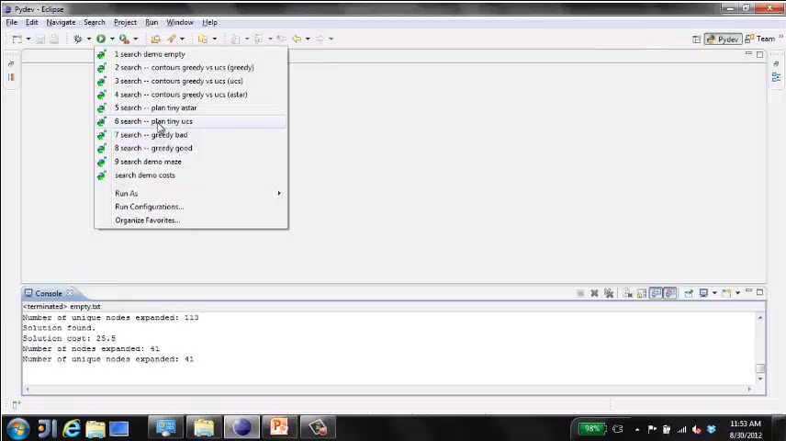
Video of Demo Pacman (Tiny Maze) – UCS / A*

Slide 46
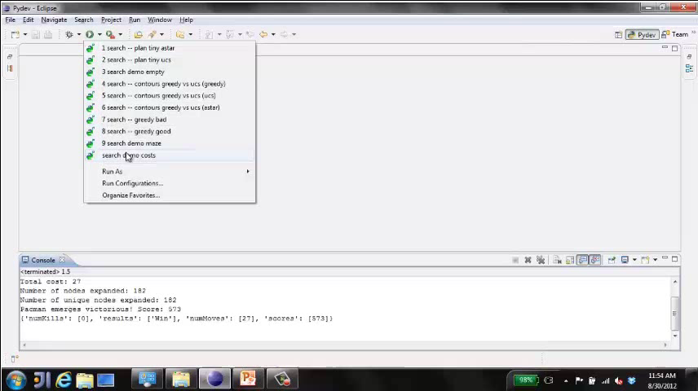
Video of Demo Empty Water Shallow/Deep – Guess Algorithm

Slide 47

A*: Summary

Slide 48

A*: Summary
A* uses both backward costs and (estimates of) forward costs
A* is optimal with admissible / consistent heuristics
Heuristic design is key: often use relaxed problems

